Slide 1
Southeast District Narragansett Council
Welcome to the March Cub Scout Breakout Session!

Slide 2
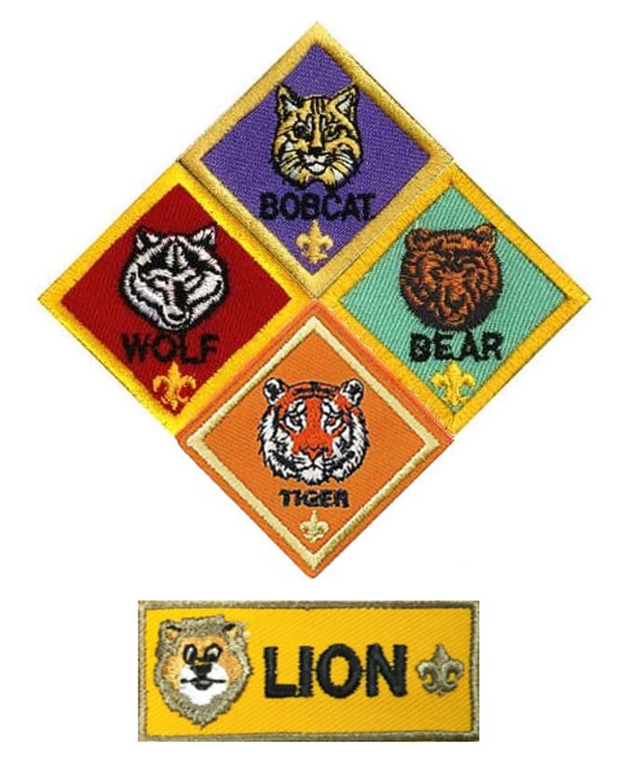
Agenda
Welcome
Introduction and Announcements
Cub Scout Pinewood Derbies

Slide 3
Notes:
Welcome – One minute
A program-specific roundtable commissioner for roundtables calls the meeting to order and starts welcoming all participants to the meeting. Start on time. It is unfair to those who arrived on time to have to wait. Beginning with an enthusiastic greeting will set the tone for a fun evening of learning and fellowship.

Slide 4
Introductions and Announcements
Introductions
New Attendees
Staff
Visitors
Announcements
Check the Website of Regional Pinewood Derby Events
Spring Break At Champlin – April Vacation
Adventure Base Camp at Champlin
Notes:
Introductions – Four minutes
Although you have already welcomed those in attendance, extend a special welcome to newcomers. You may wish to present them with special recognition or a certificate. Make them feel welcome so they’ll bring additional unit leaders with them to the next roundtable.
Be sure to explain the flow of the evening’s activities. Take care of housekeeping items such as the location of restrooms and any policies specific to the building in which you are meeting. This is especially important for your newcomers—do not assume everyone already knows.
Announcements
Limit each announcement to a short introductory statement about the event and where more information can be found, such as fliers and websites. Do not let announcements hijack the time and program needs of units! Keep them to a minute or less and emphasize that the fliers contain detailed information.

Slide 5
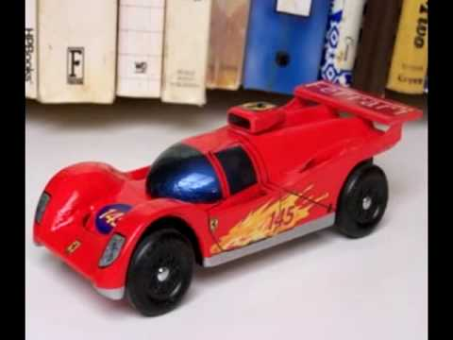
Interest Topic: March
CUB DERBIES
Notes:
Cub Scout Interest Topic – Ten minutes

Slide 6
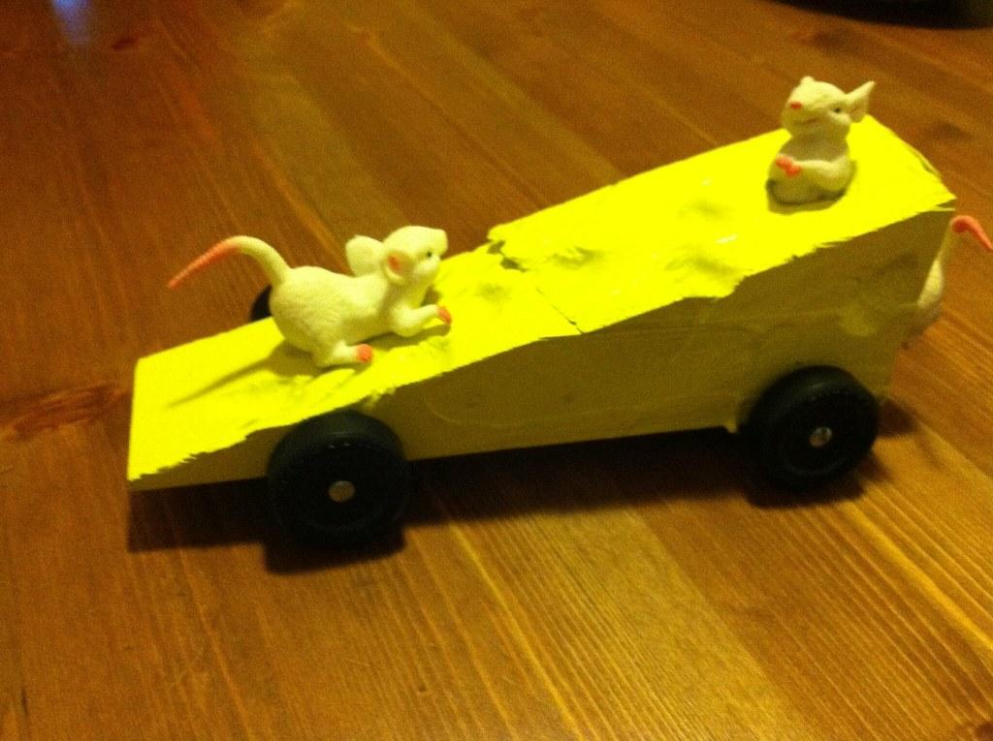
Cub Derby Takeaway:
Lots of FUN!!
Design, Develop, & Deploy
Character Building
Notes:
Racing in a Cub Scout derby is great fun. Each Scout gets to design a racing vehicle, work with a parent or other adult to build it, and see it perform on race day. Win or lose, Scouts can take pride in having done their best. Participants learn craft skills, the rules of fair play, and good sportsmanship—things they will remember all their lives.

Slide 7
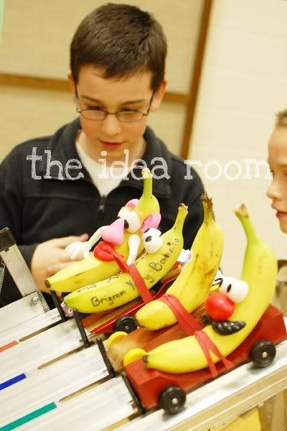
Why A derby?
Tradition – since May 15, 1953
Develop creativity
Learn New Skills
Character building lesson – be happy for fellow scouts when we don’t win.
Notes:
Derbies are a great way for Cub Scouts to create a vehicle and race against their peers. They help the Scouts show creativity, learn new skills, and show they can “take the high road” when things don’t go their way. Derbies are a great tradition for packs to revisit each year. But where do you start?

Slide 8
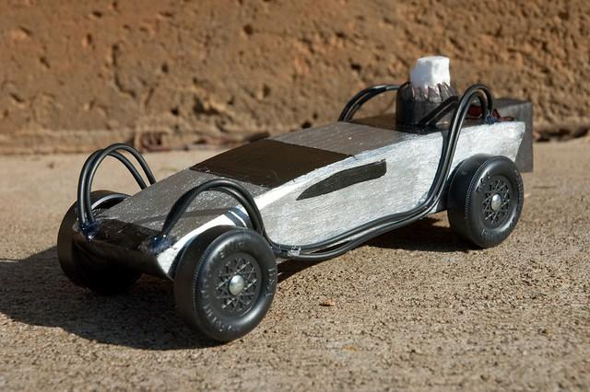
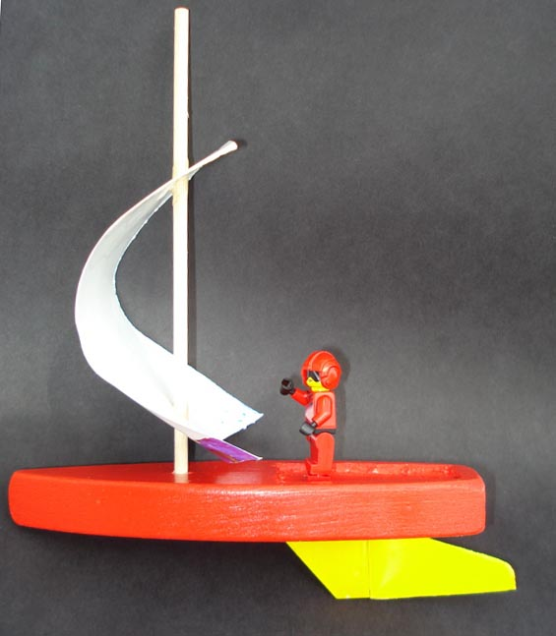
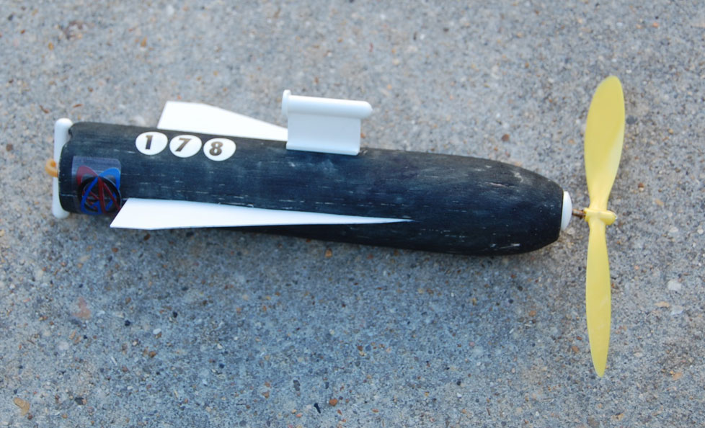
Cubs – Build Your Own?!
Pinewood Derby Car
Regatta Boat
Space Derby Rocket
Notes:
Whether building a pinewood derby car, a regatta boat, or a space derby rocket, the task is a bonding experience for parent and Scout. The Cub Scout isn’t—and shouldn’t be—expected to do it all alone. But what about when Mom or Dad takes on a little too much of the work? Make the task age-appropriate, and let the parents know what level of effort and skill their Cub Scout should be able to do. Tigers might need more of a helping hand designing and making their derby vehicle, while most Webelos Scouts know the science and the skills needed to make a race winner.

Slide 9
You Can Do It!! (with a little help)
Remember - age appropriate
Council Regulations
Host a workshop
Have a separate race for parents and siblings. Use as a fundraiser.
Notes:
Check the rule book. Whether it’s cars, boats, or rockets, does your local council or district have special derby rules and regulations? If so, you should adopt those same rules for your pack’s derby. Following the council’s rule book makes your winners eligible for district- and council-level derbies. And it ensures a level race for all Scouts.

Slide 10
Event Planning
Schedule Wisely
Tournament brackets
Elimination style
Round robin style
Stagger Starting Times
Younger to older or older to younger
Have different arrival times to eliminate waiting
Have different award ceremonies to allow families to leave early
Know your pack!
Notes:
Create a tournament bracket that gives each Scout several races, even if he loses them all. Try ideas like double elimination, lane rotation, and other formats. Scheduling is a decision for you and other Scouters. Elimination-style races, where the first racer across the finish line wins, are the most exciting for live viewers. But these may favor the racers assigned to “fast lanes”—flaws in some tracks or rain gutters where one lane is faster than others.

Slide 11
What to do in the down time?
Have activities for siblings
Concession stands
Second track
Face painting, games, coloring pages, etc.
Take pictures - photo booth, derby license
BSA guidelines regarding social media, posted at: www.scouting.org/Home/Marketing/Resources/SocialMedia.aspx.
MAKE MEMORIES & HAVE FUN!!
Notes:
Families who have other children often bring siblings to the event. To avoid chaos, it’s best to have something to help keep the siblings occupied. Set out a big container of Legos for the siblings of racers to enjoy during the derby. Distribute racing-themed coloring pages and colored pencils. Set up a game room with board games or maybe a TV with a video game system. Invite someone to run a face-painting station or make balloon animals. Whatever you do, be sure to offer something to keep those non-racers occupied.
A maximum of four Scouts will be racing at any one time. So what will Scouts and parents do between races? They can cheer on their fellow Scouts. They can purchase food at a concession stand operated, perhaps, by a local Scout troop or Venturing crew. They can race their cars on a designated secondary track for practice and fun. If your event does not allow the car or boat to be touched once checked in, a secondary track could be used to allow participants who are not advancing to another round to continue the fun.

Slide 12
Thank You...
Notes:
Five minute to move to program areas

