Slide 1
Be sure to delete the placement guides before downloading pdf file for printer.
The inner blue dotted line is the “safe zone” for your content.

Slide 2

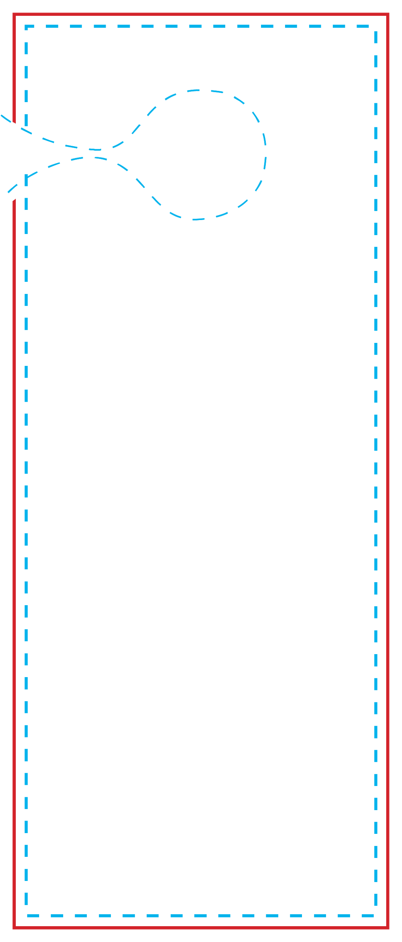

Slide 3

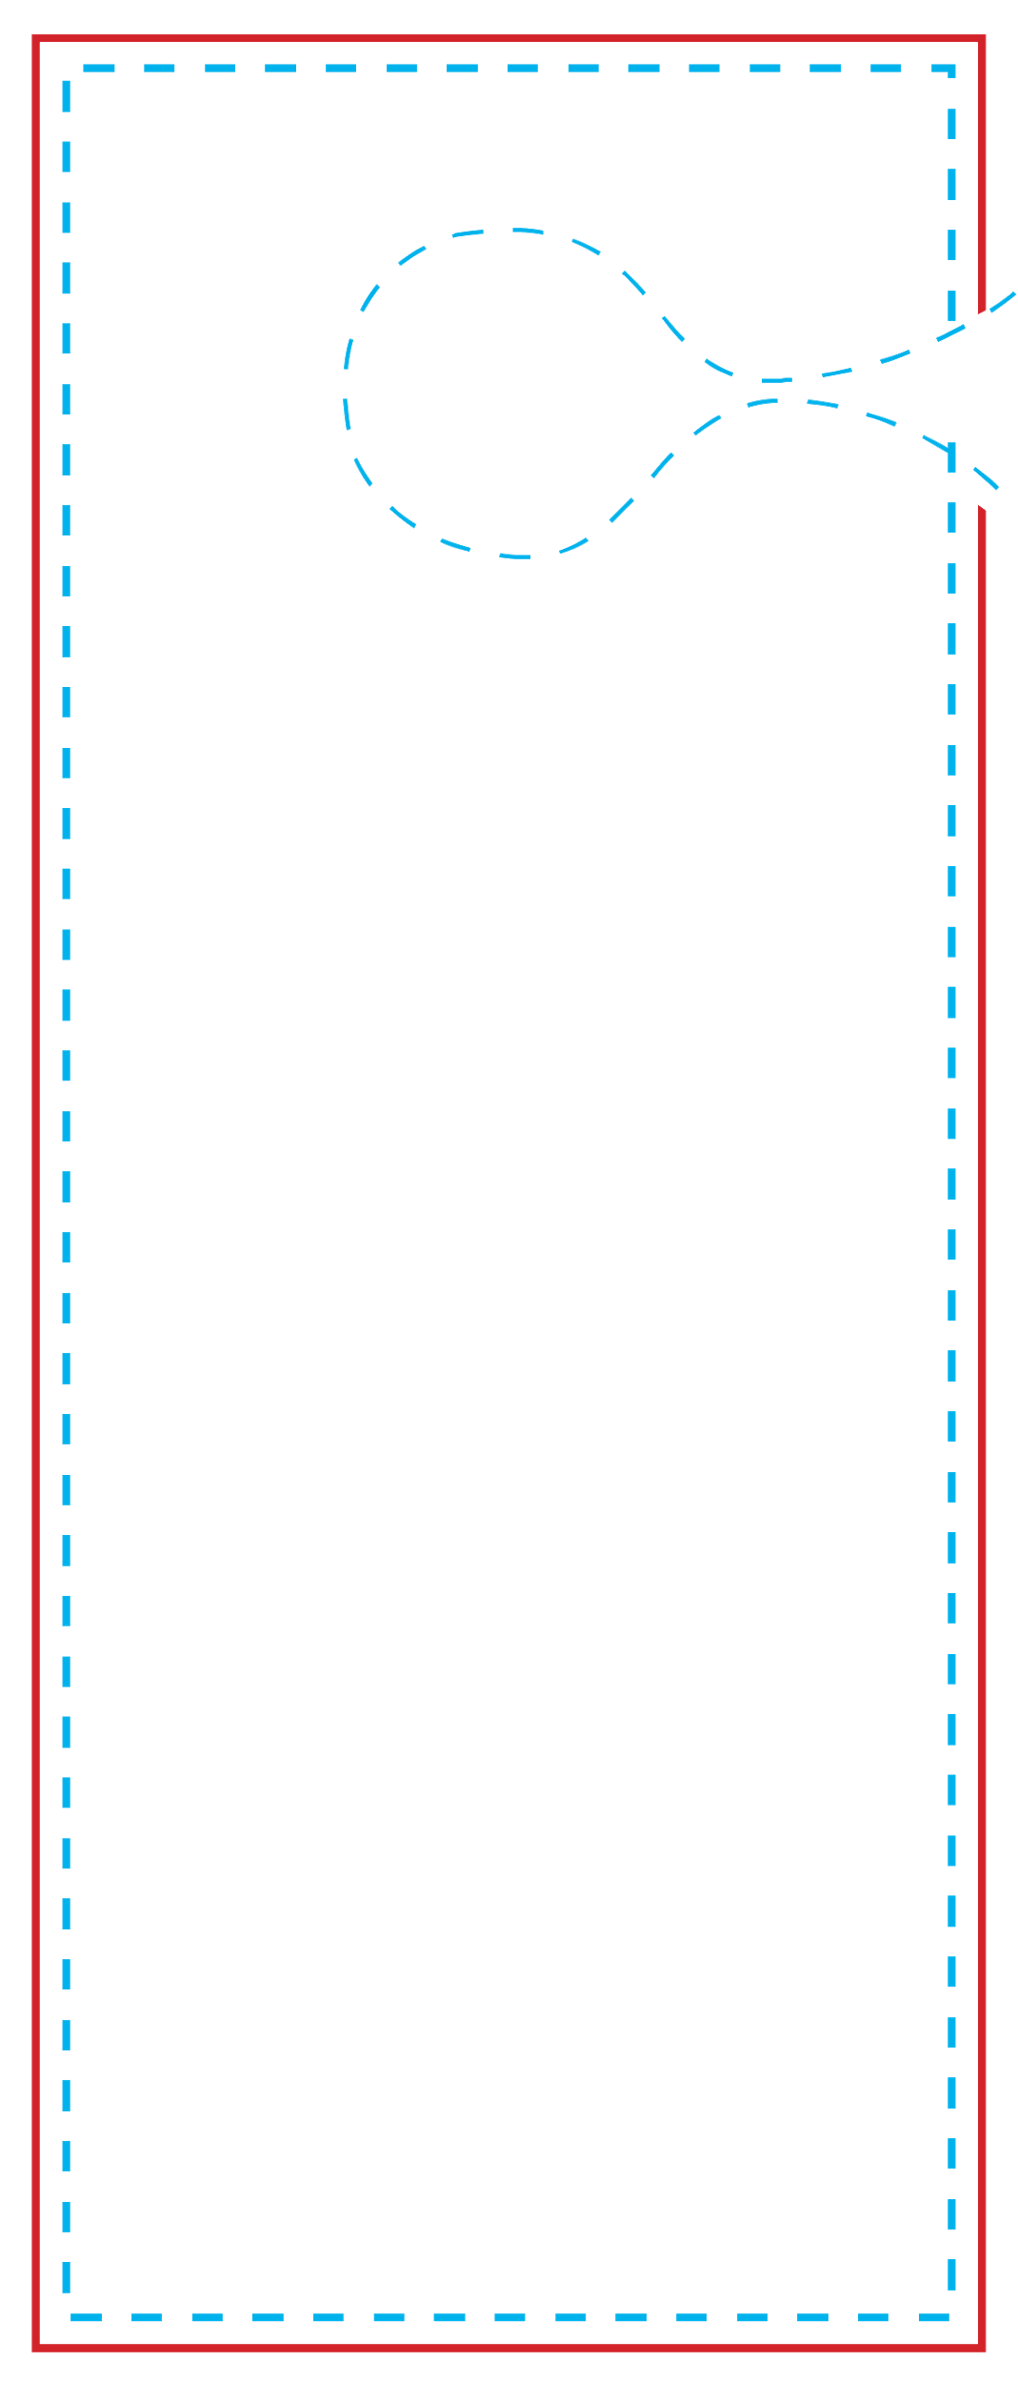
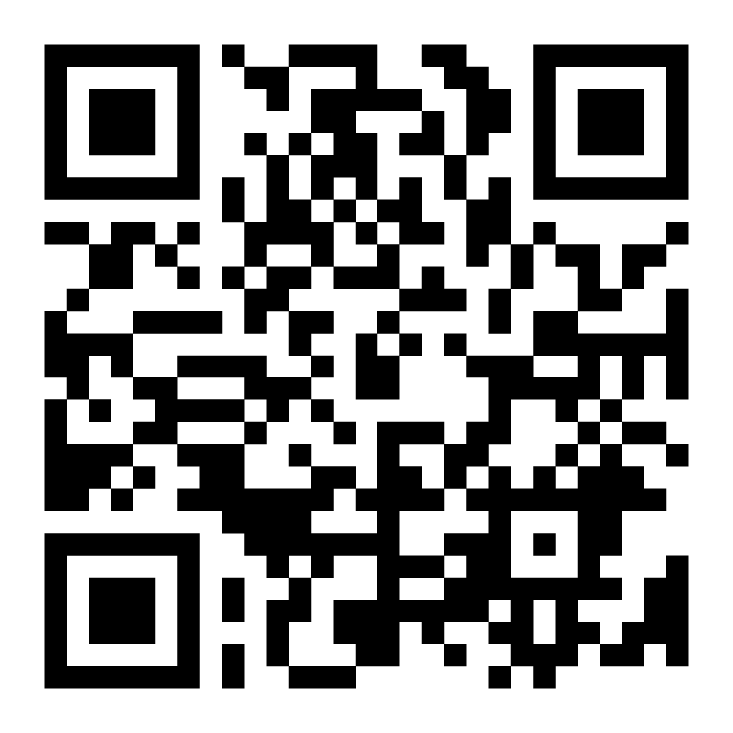
Insert Product name & images here.

