Slide 1
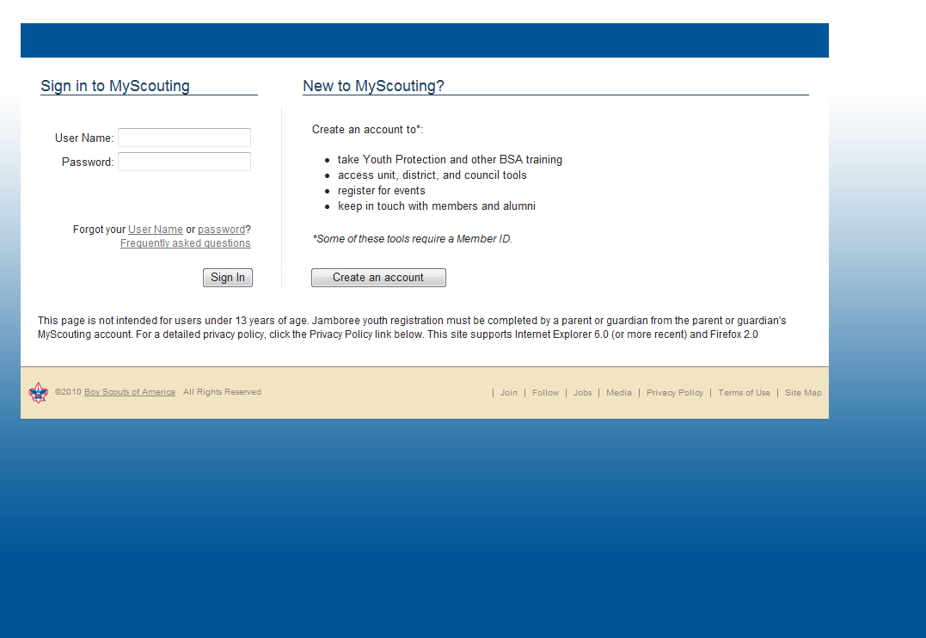
Notes:
The first “to do item “is for unit leaders to set up their unit pin
The unit leader, which is the (Cubmaster, Scoutmaster, crew advisor along with the unit committee chair and the chartered organization rep) enters the Be A Scout Pin and Leads Management Database by logging into their myscouting account.

Slide 2
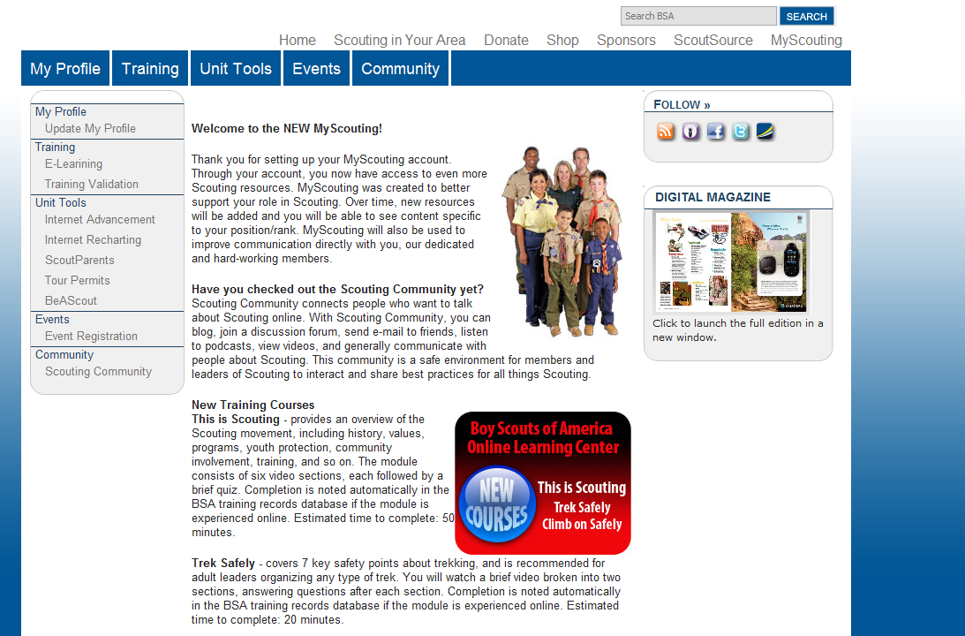
Notes:
Once myscouting opens, a Unit Leader will see the BeAScout link on the left in the menu. Again, for first time set up we are defining Unit Leaders as Cubmasters or Scoutmasters or Crew Advisors, along with Unit Committee Chairs and Chartered Organization Representatives.

Slide 3
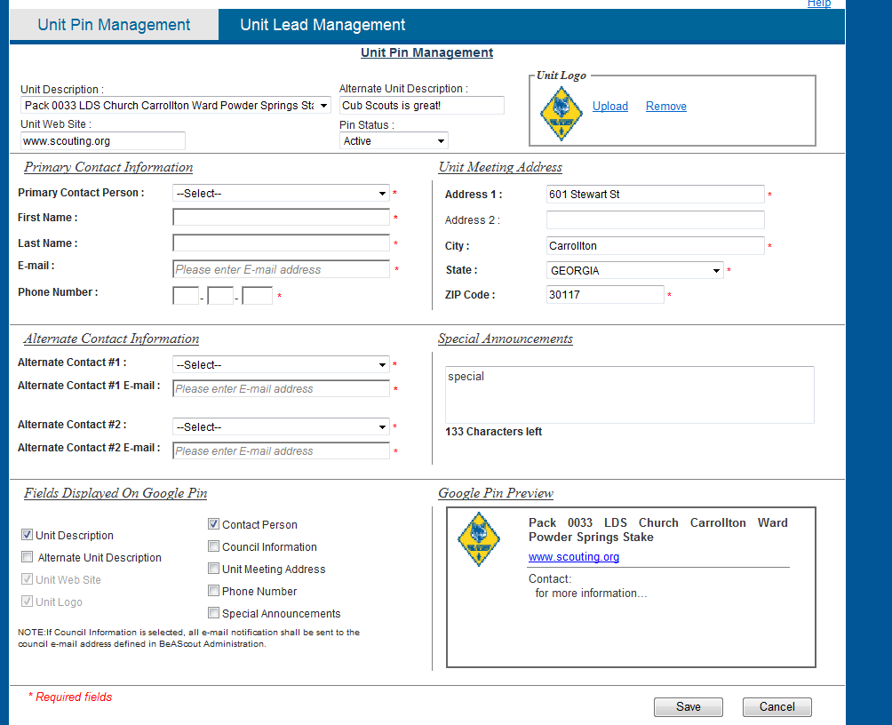
Notes:
There are two options.
First, Unit Pin Management: Unit Leaders use this to edit PIN information.
Next, Unit Lead Management: Unit Leaders use this to manage incoming requests for information from parents interested in Scouting.
We begin our review of BeAScout with Unit Pin Management

Slide 4
Notes:
When you click on unit pin management gadget at the top right, up pops this page
The Unit PIN management is used to set what the parent sees on the Google map when hovered over or clicked on. Filling out this information correctly is imperative to successful leads generation.
There are two important areas we would like to call to your attention.
At the bottom right in the solid red box is a preview of the Google PIN
Pay close attention to this box as we review the next several pages. It will become evident to you how this information is generated and what will be seen by the parent on Google.
At the bottom left is the “Fields Displayed on Goggle Pin” area. The Pin preview box will only display the information that has the box(s) checked.

Slide 5
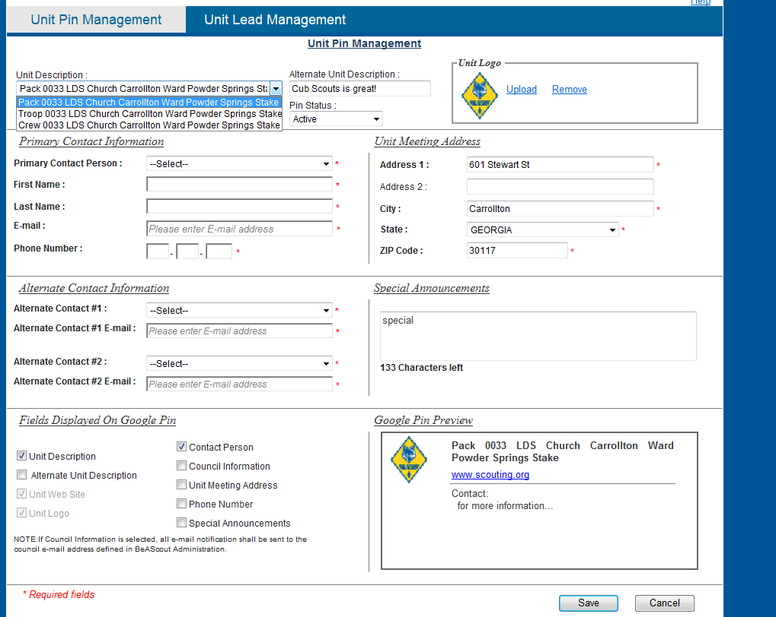
Notes:
Step one in Unit PIN Management is to select the correct unit. Unit leaders may be registered to more than one unit. Leads are grouped by unit.

Slide 6
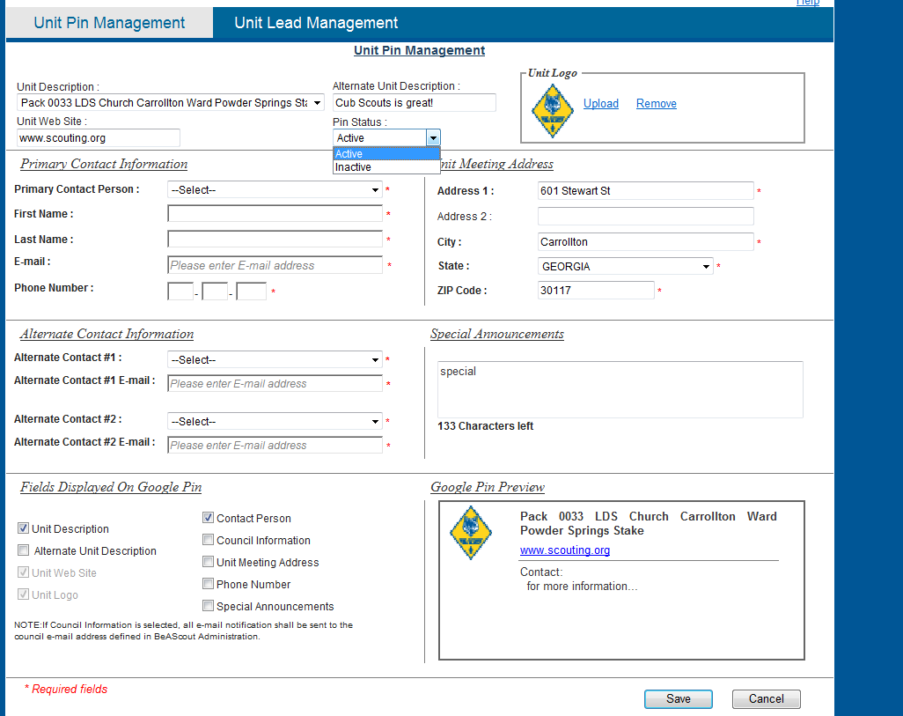
Notes:
All PINS will show an active status at first. A unit leader can deactivate the PIN by changing the PIN status to inactive—by doing this the pin will not appear on the Google map. Another option, however, is to leave it active and choose to use Council information for leads generation. That way someone at the Council will continue to get and work leads while a unit leader may be away.
The Unit logo can be selected in the box in the top right side.

Slide 7
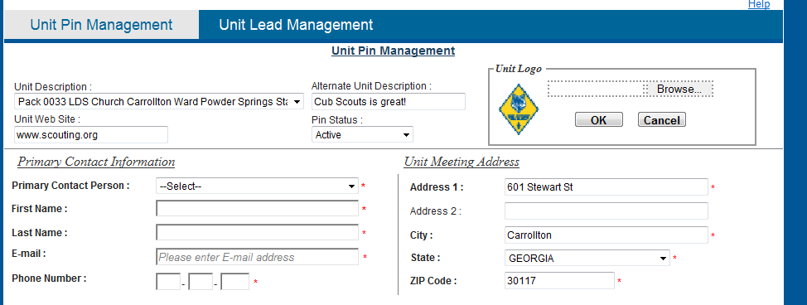
Unit logo
.jpg format
2 mb max file size
Notes:
The unit logo is defaulted to the logo for the traditional program it correlates to.
For example,
All packs will have the Cub Scouts logo.
All troops will have the Boy Scouts of America logo.
All crews will have the Venturing logo.
A units personalized logo can be used.
The Unit logos should be a .jpg format.
And the Unit logos’ maximum file size is 2mb.

Slide 8
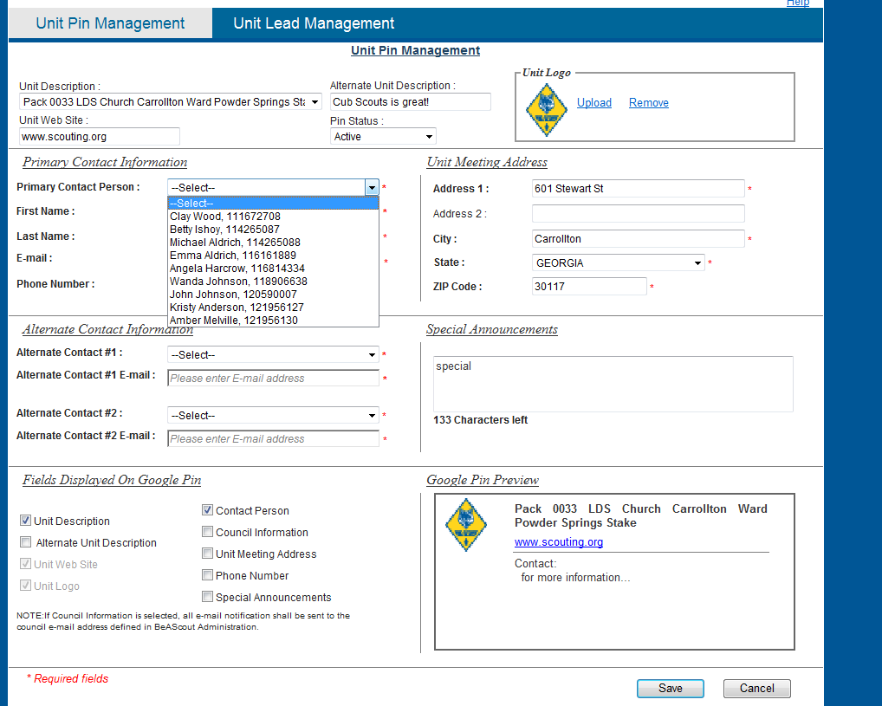
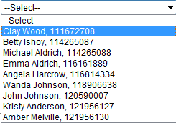
Notes:
The “Primary contact information” refers to whom the unit has chosen to be the lead in managing the PIN information and the parent requests. This does not have to be the Unit Leaders, but must be a registered adult from that unit. BeAScout “talks” to our Scoutnet or PAS system and updates the information of registered adults
This person will also have access to the Unit Pin Management and the Unit Lead management page by signing onto MyScouting. It is also the person receiving emails generated from the Google Map PIN. So a Unit Leader can assign another registered adult to work the leads.

Slide 9
Notes:
The unit meeting address can be changed at any time. The address displayed is pulled from ScoutNET or PAS. This address will be used to locate the Goggle Pin on the map, and can be used to be displayed on the pin. If a unit is having a special meeting location or does not meet at their Chartered Organization, the address can be changed.

Slide 10
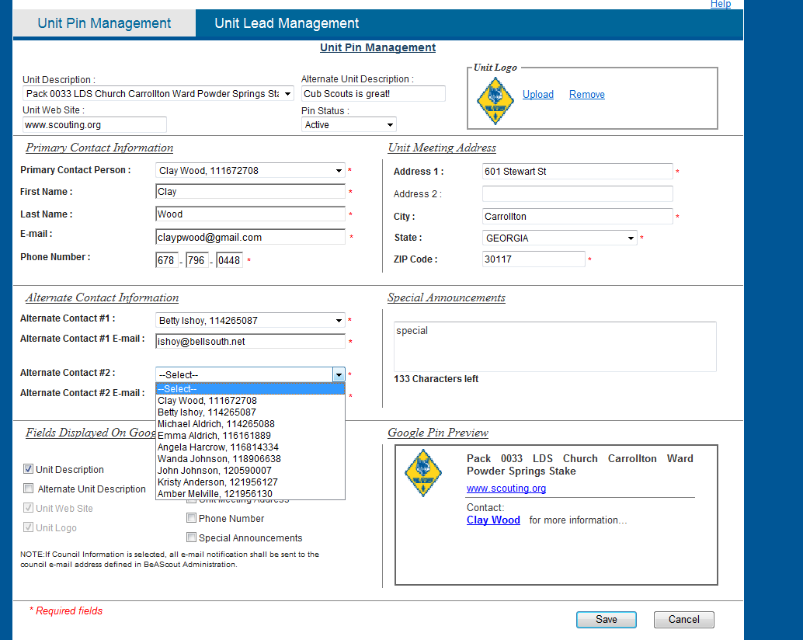
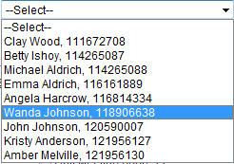
Notes:
The Alternate Contact Information fields are mandatory. These fields are named, respectively, Alternate Contact 1 and Alternate Contact 2. For all three contacts (the primary and two alternates) the email on file in the contacts PAS record will auto-populate the field once the name is chosen. Should that email address need to be changed or phone number need to change it can be manually done on this page (but it does not update any PAS or ScoutNET record.
The primary and both alternate contacts must have different email addresses or an error will occur. All three email addresses will receive an email when a lead is generated. The parent will only have information on the primary contact in the Google PIN.
Once completed, there will be six individuals who have access to Unit Pin Management (as well as unit lead management) via MyScouting.org:
1. the Primary unit leader (Cubmaster, Scoutmaster, or crew advisor)
2. Unit committee chair
3. Chartered Organization Rep
4. Primary contact
5. Alternate contact #1
6. Alternate contact #2

Slide 11
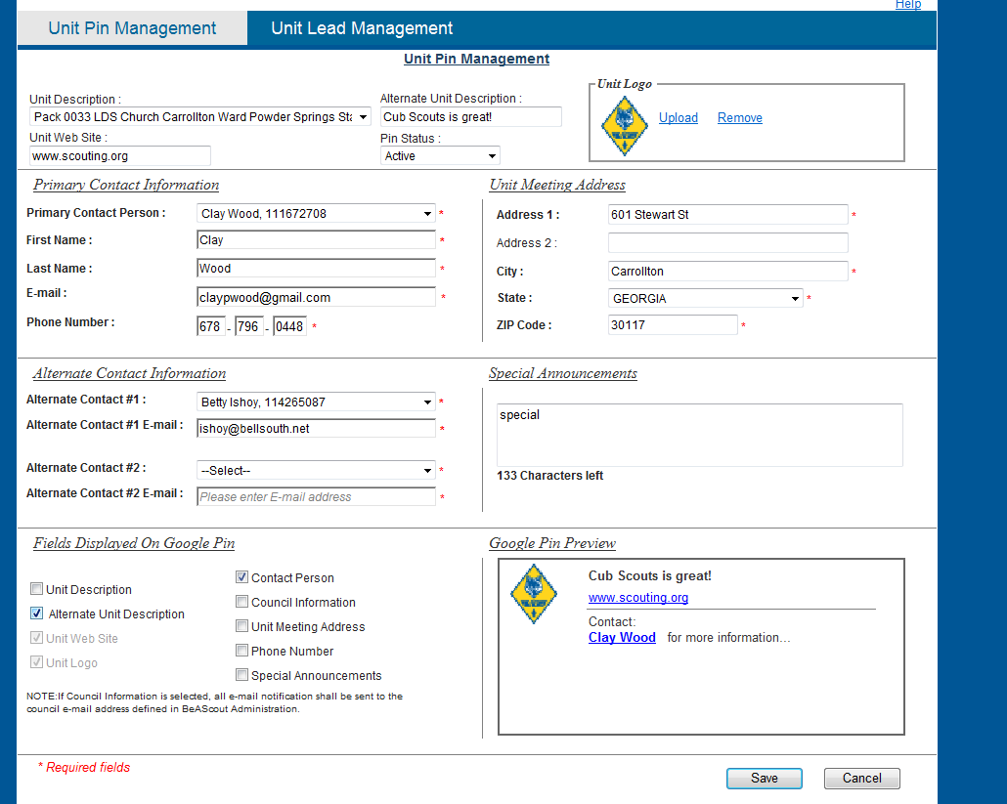
Notes:
An alternate unit description may be used but it is not mandatory. This unit description could be something as simple as a slogan. Remember the Unit description box is reading from PAS or Scoutnet. In our example the unit description reads Pack 0033, perhaps the unit locally is know as Pack 33, that could be written in the alternate unit description box.
Following the diagram: at the top of the page we inputted an alternate description. We must check the box in the “Fields Displayed on the Goggle Pin” in the lower left side.
And that enables the alternate description to appear in the Goggle Pin Preview.

Slide 12
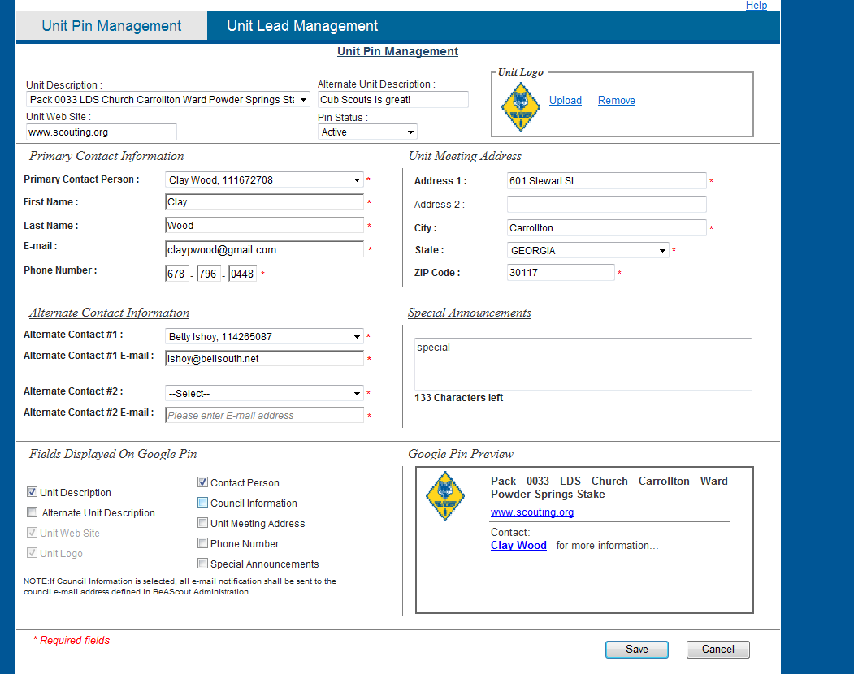
Notes:
If a unit leader chooses, he or she may make the Council information display in the Google PIN. By selecting Council information, all Unit information goes away with exception of the Unit Description, here – Pack 0033.
In order for the “contact person” to display in the PIN, the “contact person” check box must be checked.

Slide 13
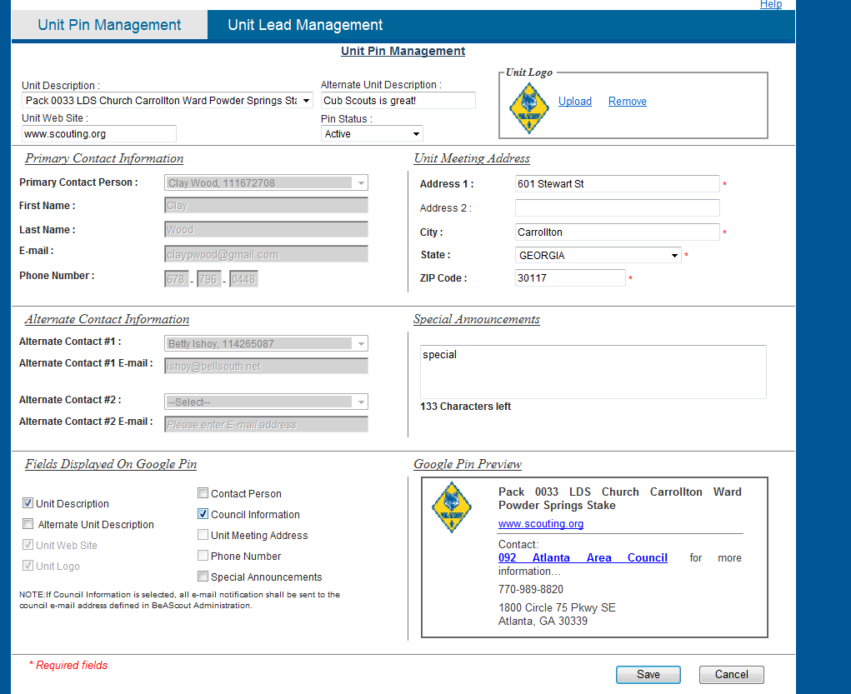
Notes:
Once switched, the Council’s information automatically is displayed in the preview and on the Google Map, once saved.

Slide 14
Notes:
If the unit meeting address is the desired information to display, this box must be checked. Checking this box, displays the address in the preview. This can be changed as the unit sees fit for where the unit is meeting. If the unit does not wish the location to appear on the pin, uncheck the box in the “Fields Displayed on the Google Pin”, but an address must be in the Unit Meeting Address box at the top right so the pin can be on the map.

Slide 15
Notes:
The Unit Leader phone number is only displayed if checked in the fields to be displayed box. This number is pre-populated from the adult leaders’ PAS record. Remember by doing this the phone number will be on the web for all to see. If a telephone number is not desired in the PIN, be sure to uncheck this box.

Slide 16
Notes:
This example shows how the telephone number displays.

Slide 17
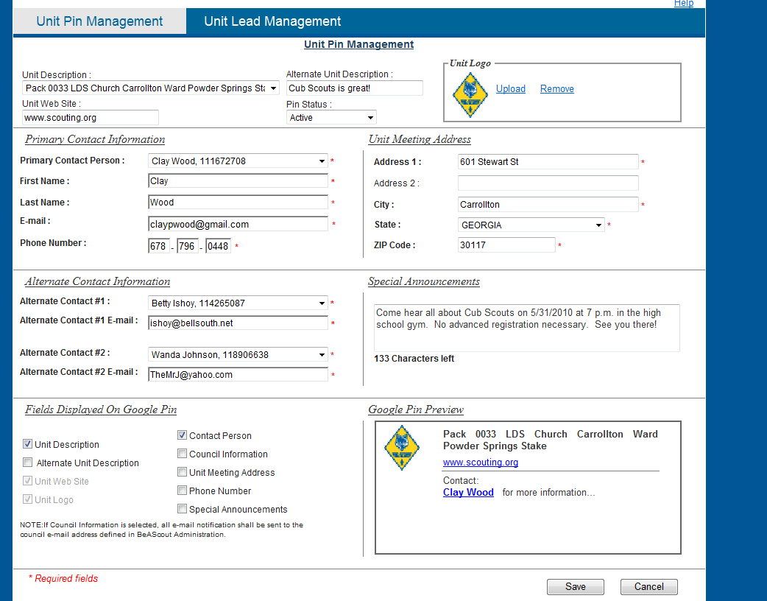
Notes:
Special Announcements can be used for any purpose to display an announcement on the Unit PIN.
What you type in the box will appear in the PIN info and once again remember to check that box in “Fields Displayed on Google Pin”.

Slide 18
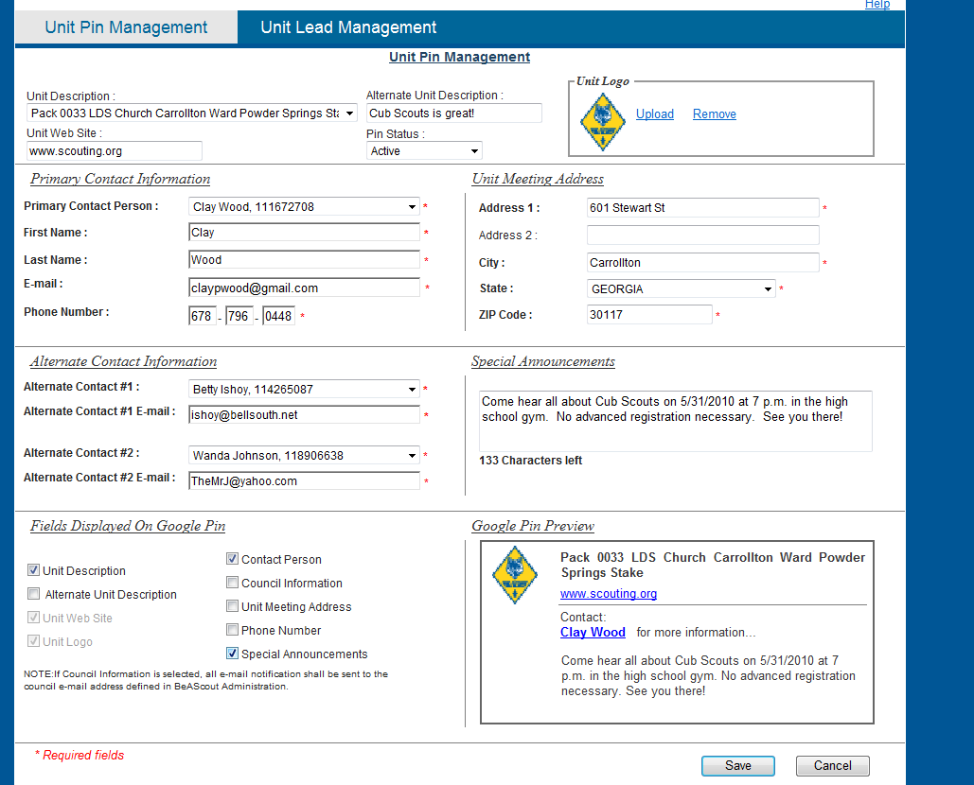
Notes:
This is an example of the Special Announcement once showing in the preview box. Review all information here and make updates or changes. Be sure to “save” your information.

Slide 19
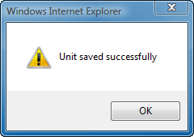
Notes:
Once you have saved your information, a window will pop up stating that the Unit saved successfully.

Slide 20
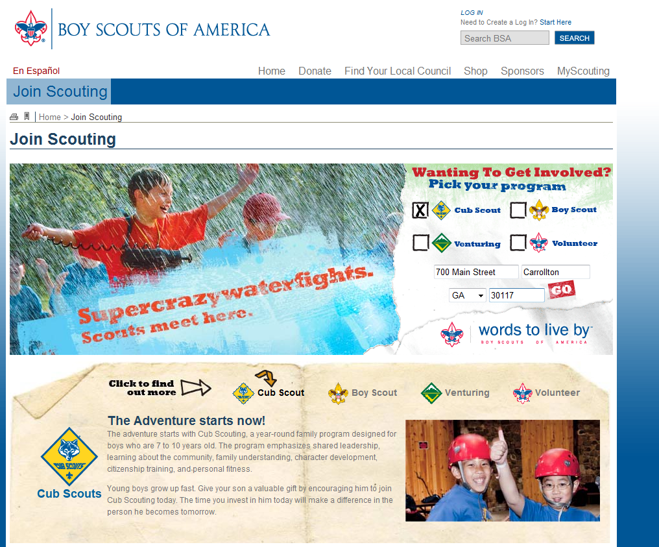
Notes:
For the fall 2010, a parent interested in finding a unit nearby can now find one by going to scouting.org and clicking on the “Join” button or open a browser and type beascout.org and press enter. Or they can type in the new web address “beascout.org”. We are suggesting that councils use the beascout.org address on all flyers, yard signs, posters, stickers---and put a link on your council’s home web page.
Once in the “Join Scouting” page, pick a program for your son and type in your home address and hit the Go button… you’re on your way.
Also notice the program information is available in the lower part of the home page.
The ages will be added to this page in the near future so that parents know where their kids fall in which program.

Slide 21
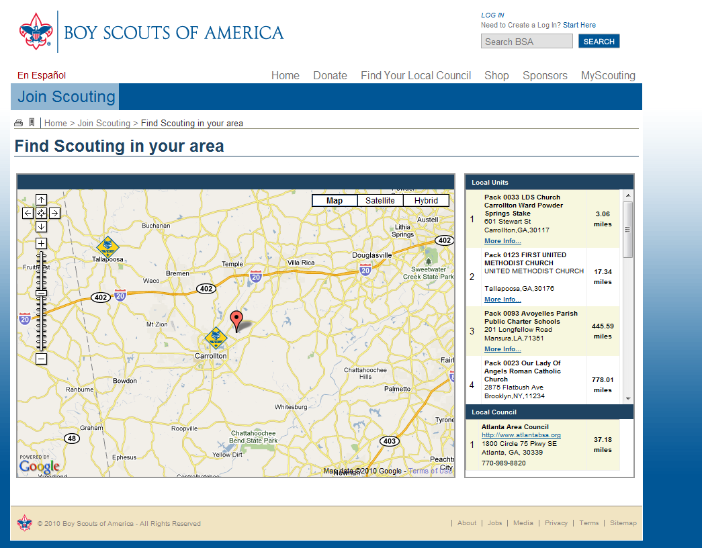
Notes:
A Google Map is displayed showing an icon for all the active unit types chosen previously. Other units of the same type (in our example Cub Scout Packs) are displayed and all unit addresses can be seen on the right side of the Google Map listed in order of proximity to the home address entered by the parent.

Slide 22
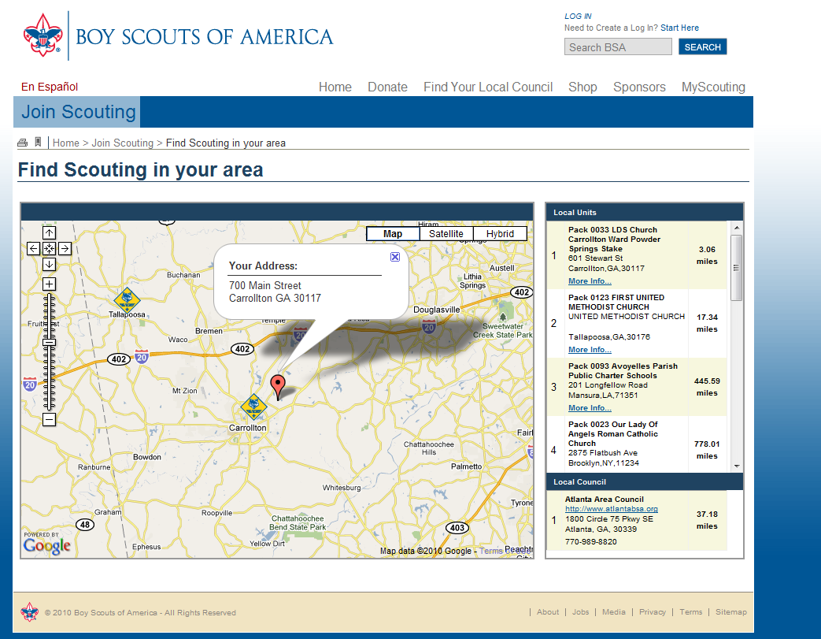
Notes:
The red pin is the location of your home. This helps to gauge how far a unit is from your home.

Slide 23
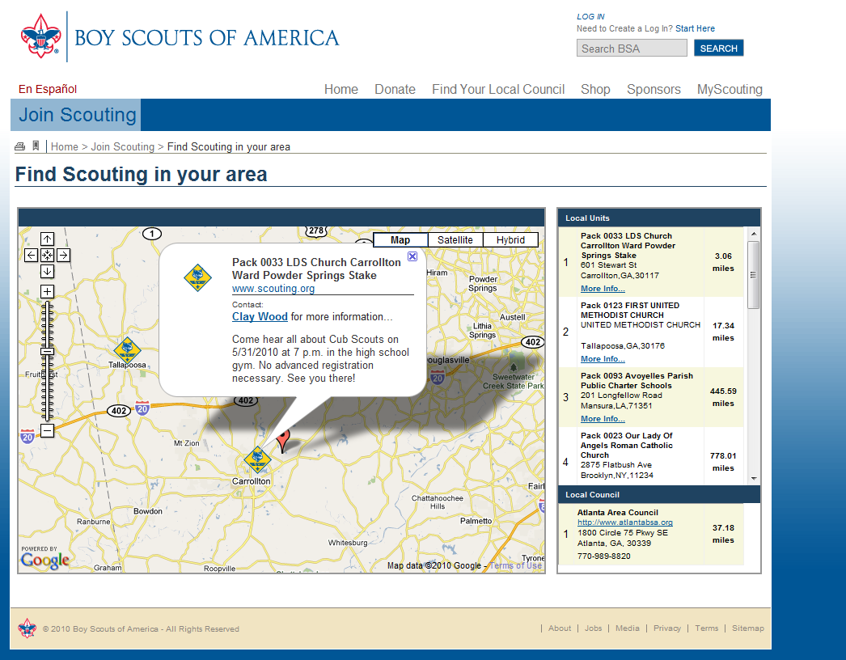
Notes:
By clicking on the unit of your choice, the Unit PIN information is displayed. (Remember: This is the information that was previously updated by the Unit Leader before, in the PIN management process.)
Click on the link “more information” in the PIN bubble, or in the Local Units list on the right hand side. “More information” means the parent will provide contact details about interested parents.

Slide 24
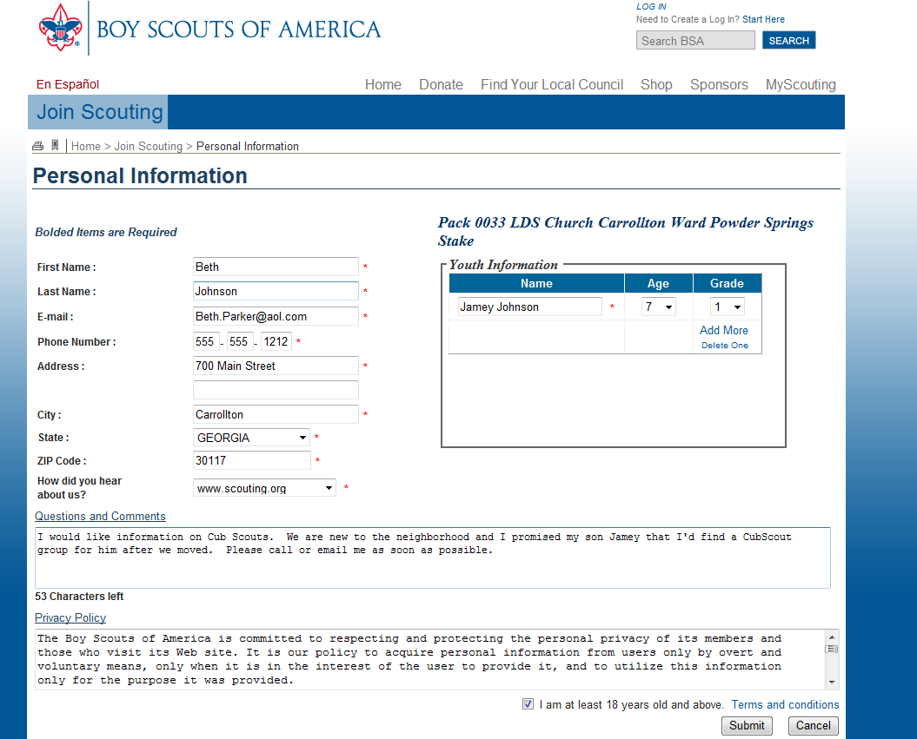
Notes:
Once they select more information, up pops :
A “personal information” screen displays, to allow the parent to give information about themselves and their child so that the Unit Leader can be sure they have selected a valid unit.
Entering the youth’s information here assures that the program choice is selected correctly.
A personal note or question can be added here. The information and comment will be sent to the Primary and Alternate Unit PIN contacts set up in the Unit PIN Management fields.
Once all fields are filled in, the parent must select the box saying they are at least 18 years of age.
Finally press submit.

Slide 25
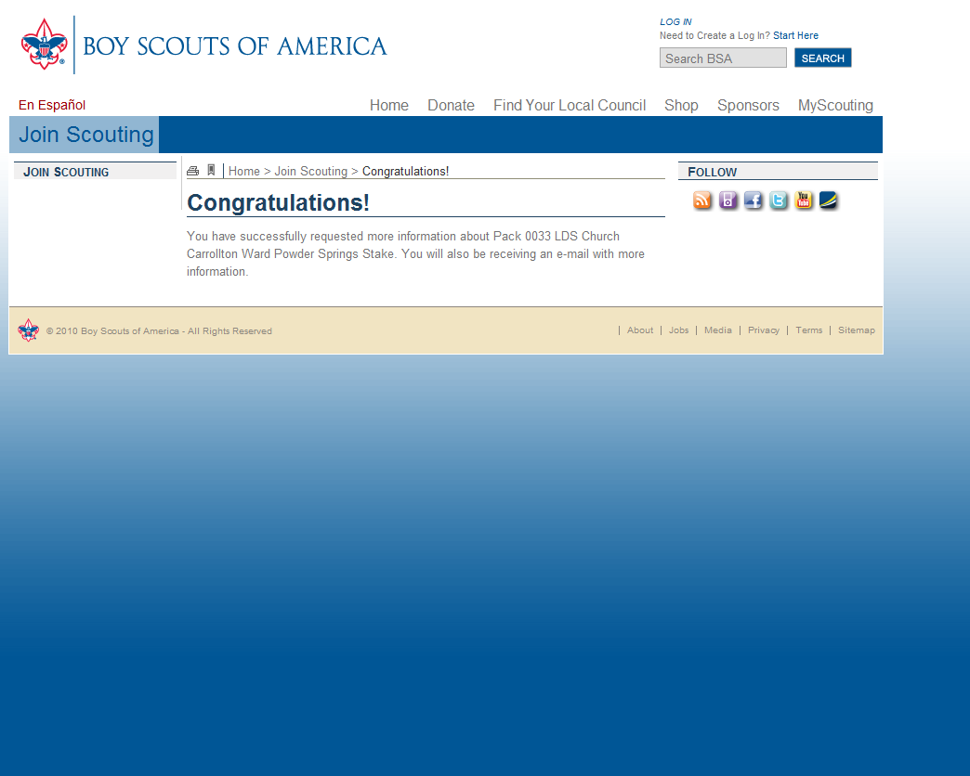
Notes:
If all fields are correct, a confirmation screen will appear saying “you have successfully requested more information, in this case… about Pack 0033.”

Slide 26
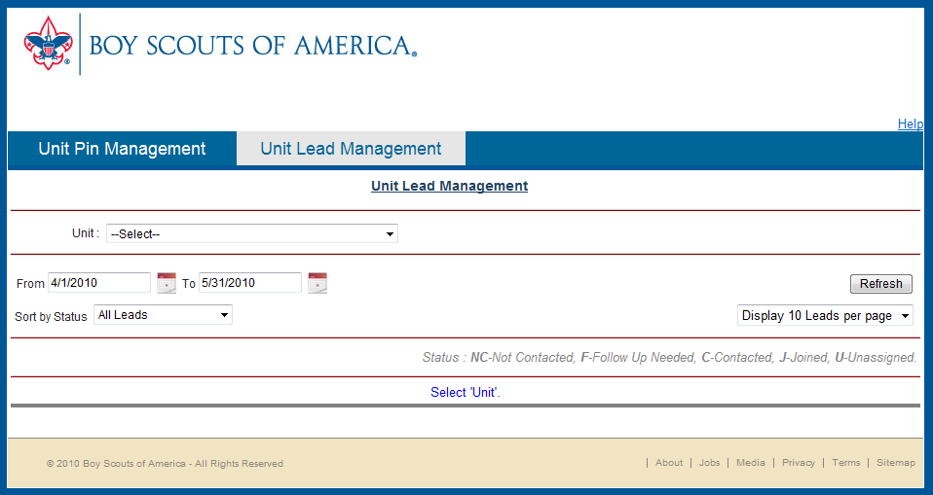
Notes:
Accessing the Unit Lead Management is via MyScouting account. And remember after the initial set up 6 individuals from the unit will have access to this information. To get to the unit lead management page click on the gadget “Unit Lead Management” at the top
The Unit Lead Management portion is used by the Unit Leaders.

Slide 27
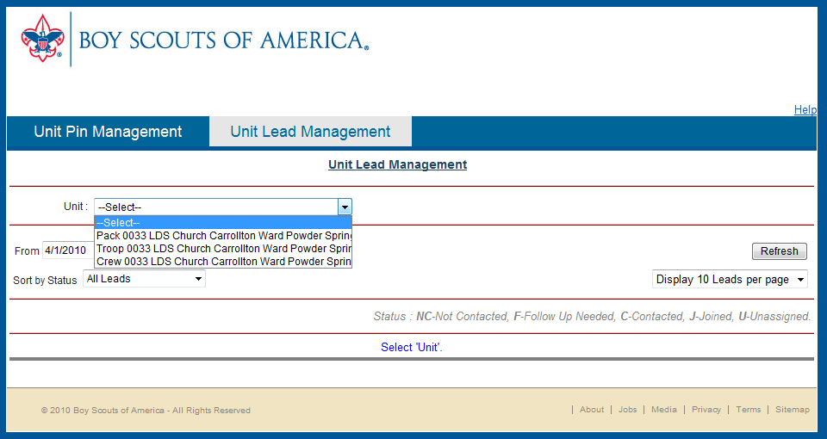
Notes:
Select the Unit to display all leads

Slide 28
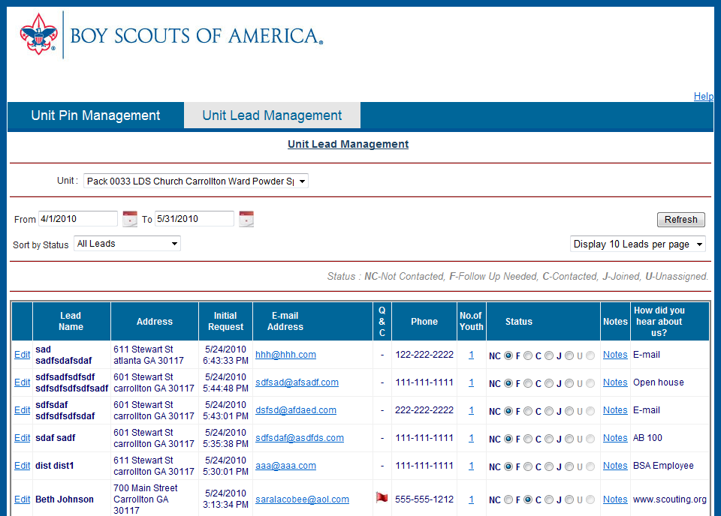
Notes:
Leads are displayed with the following categories of information in the dashboard:
Lead Name, which is the parent name
Address, of the parent/child
Initial Request time, displays the date and time of the parents initial site contact for unit leaders and councils to ensure speedy contact with the lead.
Email Address, of the parent
Q or C, displays a flag showing the leader or executive that there is additional information needed to be read through.
Next, the Phone number.
The Number of youth in the family
A status of the lead. This is a manual selection process..but more on this later
The Notes section is used for follow up. This allows each person looking at the lead to know what has been done by a previous reviewer.
…and, how did you hear about us?

Slide 29
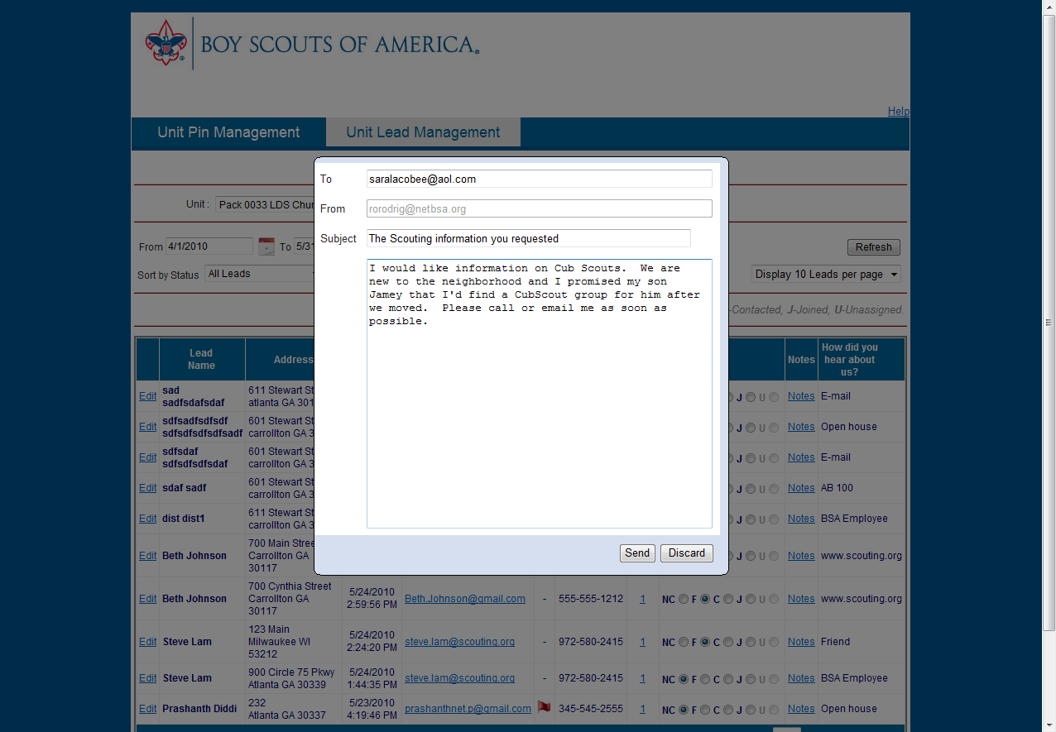
Notes:
Clicking on the red flag in the Q & C field opens a box allowing an email contact with the parent.

Slide 30
Notes:
All of the necessary information to contact this parent is on this page. Once contacted, the status of the lead should be updated—to move the radio button, leaders will need to do that manually. The statuses are displayed. The description of each status is located in the information bar above the display fields bar.
NC= not contacted
F= follow up needed
C= contacted by the unit
J= has joined the unit
U= needs to go to another unit or council

