Slide 1
Narragansett Council BSA
Southeast District
ScoutsBSA Roundtable
Breakout
March 2020
1

Slide 2
Agenda
Icebreaker
Interest Topic: Adult Leader Development
Q & A
Tips for Troop Meetings
Song / Skit
Future Program Features
Commissioner’s Minute

Slide 3

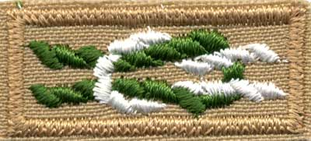
Scouts BSA Interest Topic
Adult Leader Development
Every Scout Deserves a Trained Leader
A trained leader is knowledgeable and more confident in the role being performed.
Trained leaders exhibit a knowledge and confidence that is picked up by people around them.
Trained leaders impact the quality of programs, leader tenure, youth tenure, safety, and a whole lot more.
A trained leader is better prepared to make the Scouting program all it can be!
3
Notes:
Scouts BSA Interest Topic (10-15 minutes)
(The interest topic is a feature designed to add variety to Roundtable programming. It might include a training highlight, advancement information, or any number of topics related to Scouts BSA issues.)
Today we are going to discuss a method of Scouts earning merit badges, and I’m not talking about the traditional method where a Scout contacts a merit badge counselor and and works out a schedule with them. We’re going to discuss group instruction of a merit badge as when a troop runs a program within the unit.
Let’s start the discussion with a few questions…

Slide 4
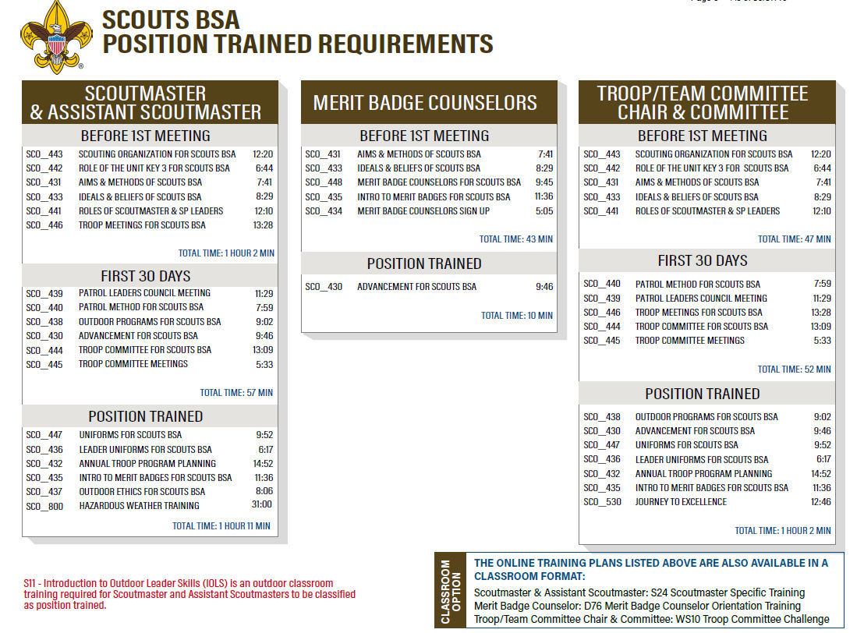
Notes:
Scouts BSA Interest Topic
By a show of hands, how many troops run a merit badge program?
Why does your troop run a merit badge program?
[Solicit participants for responses]
[Advance slide]
When determining a schedule of merit badges to offer your Scouts, how do you determine which of the 135 badges to offer and how many options at the same time? (i.e., only only choice, Scout can choose 1 of 4 options, etc.)
[Solicit participants for responses]
[Advance slide]
How does your unit go about finding qualified merit badge counselors for your program?
[Solicit participants for responses]
[Advance slide]
What benefits do you see from running a merit badge program within your troop? Are there any negatives to doing so?
[Solicit participants for responses]

Slide 5
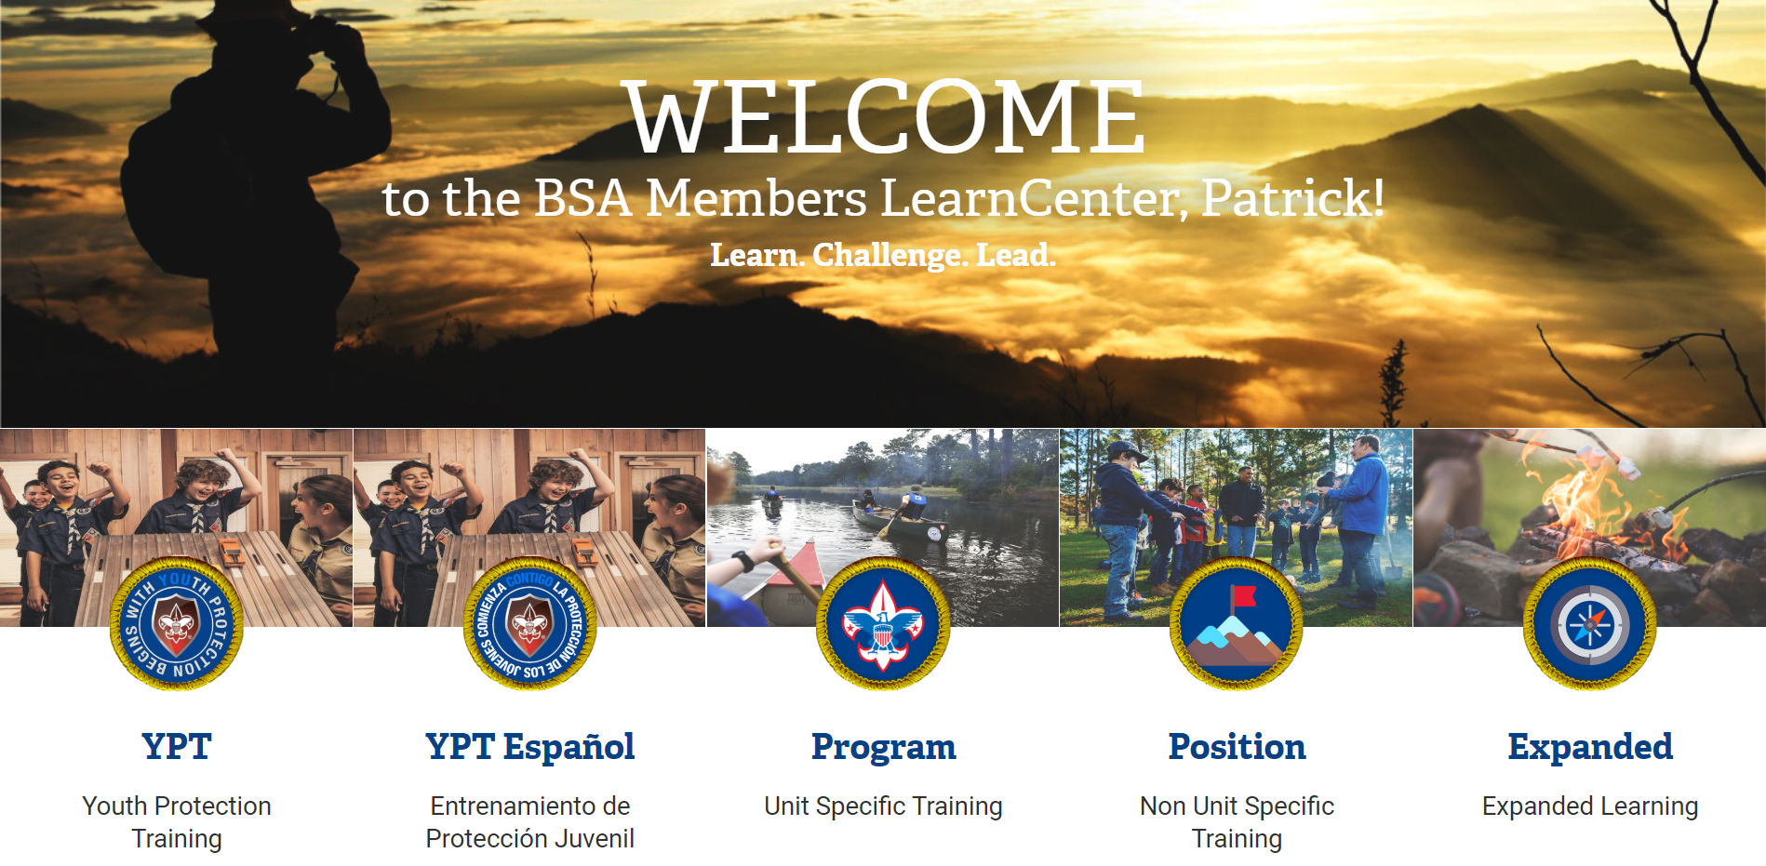
my.Scouting BSA Learning Center
Notes:
Scouts BSA Interest Topic
As we know the Application for Merit Badge, a.k.a. Blue Card, is signed off by the merit badge counselor when completed and they also initial as each requirement is completed. So who is a merit badge counselor within a troop?
[Solicit participants for responses]
[Advance slide]
Per the Guide to Advancement (Section 7.0.1.1) …[reference slide]

Slide 6
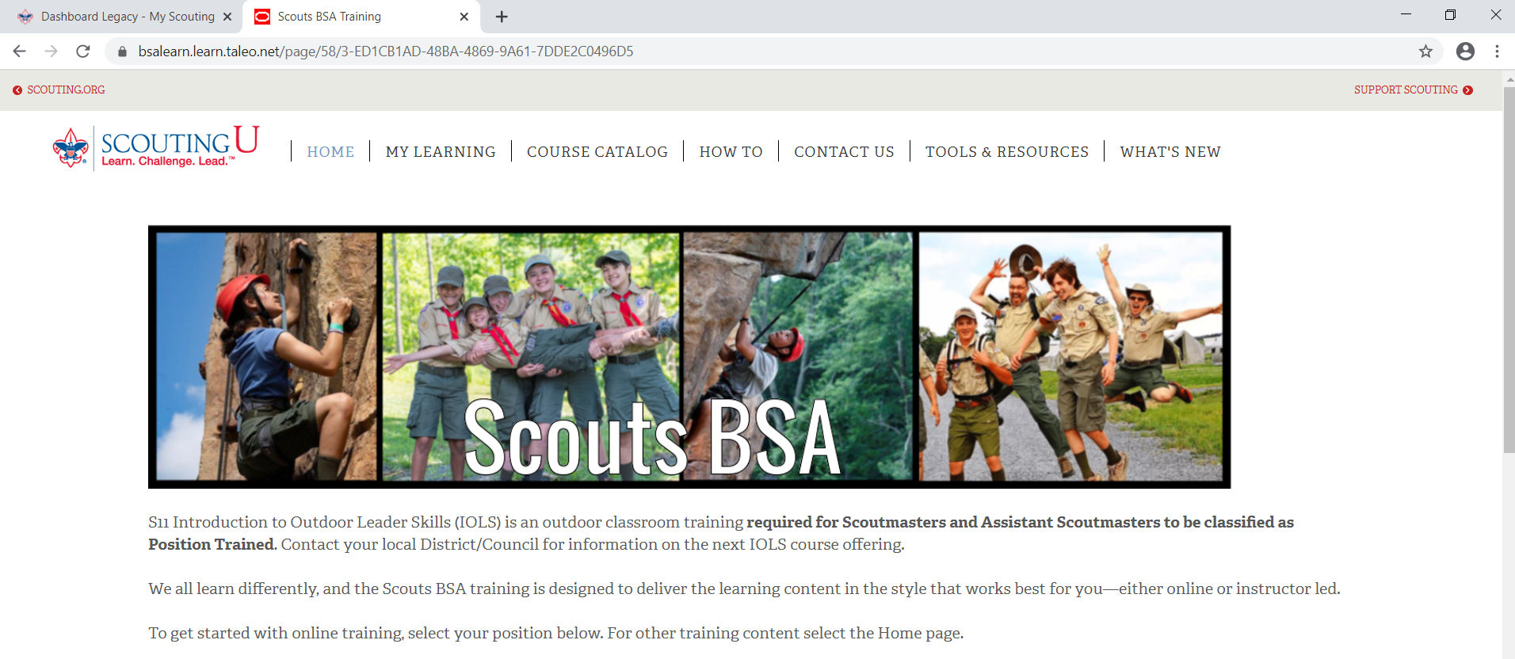
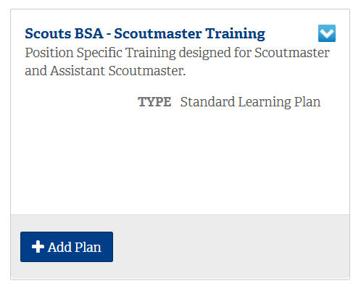
my.Scouting BSA Learning Center
Notes:
Scouts BSA Interest Topic
If you have adults in your troop serving as merit badge counselors make sure they are registered as a merit badge counselor. Even if they are registered in another position within the troop, they will need to submit a new adult application which is approved by the council advancement committee not the troop. There is no fee to register as a merit badge counselor.
The qualifications to register as a merit badge counselor are:

Slide 7
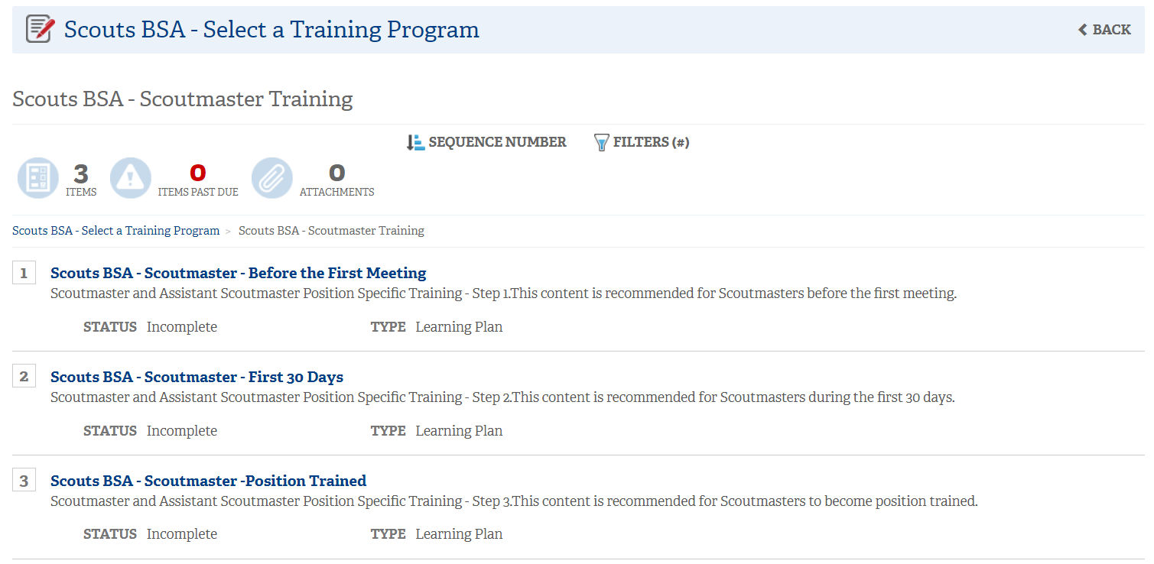
my.Scouting BSA Learning Center
Notes:
Scouts BSA Interest Topic
If you have adults in your troop serving as merit badge counselors make sure they are registered as a merit badge counselor. Even if they are registered in another position within the troop, they will need to submit a new adult application which is approved by the council advancement committee not the troop. There is no fee to register as a merit badge counselor.
The qualifications to register as a merit badge counselor are:

Slide 8
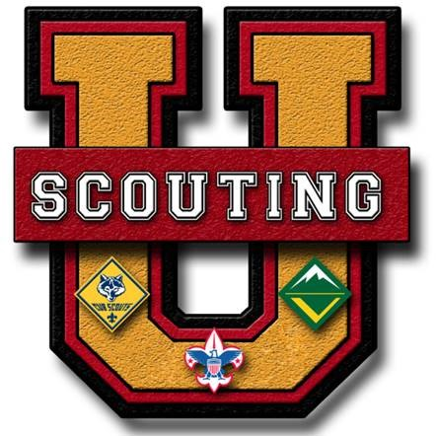

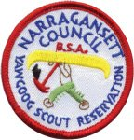
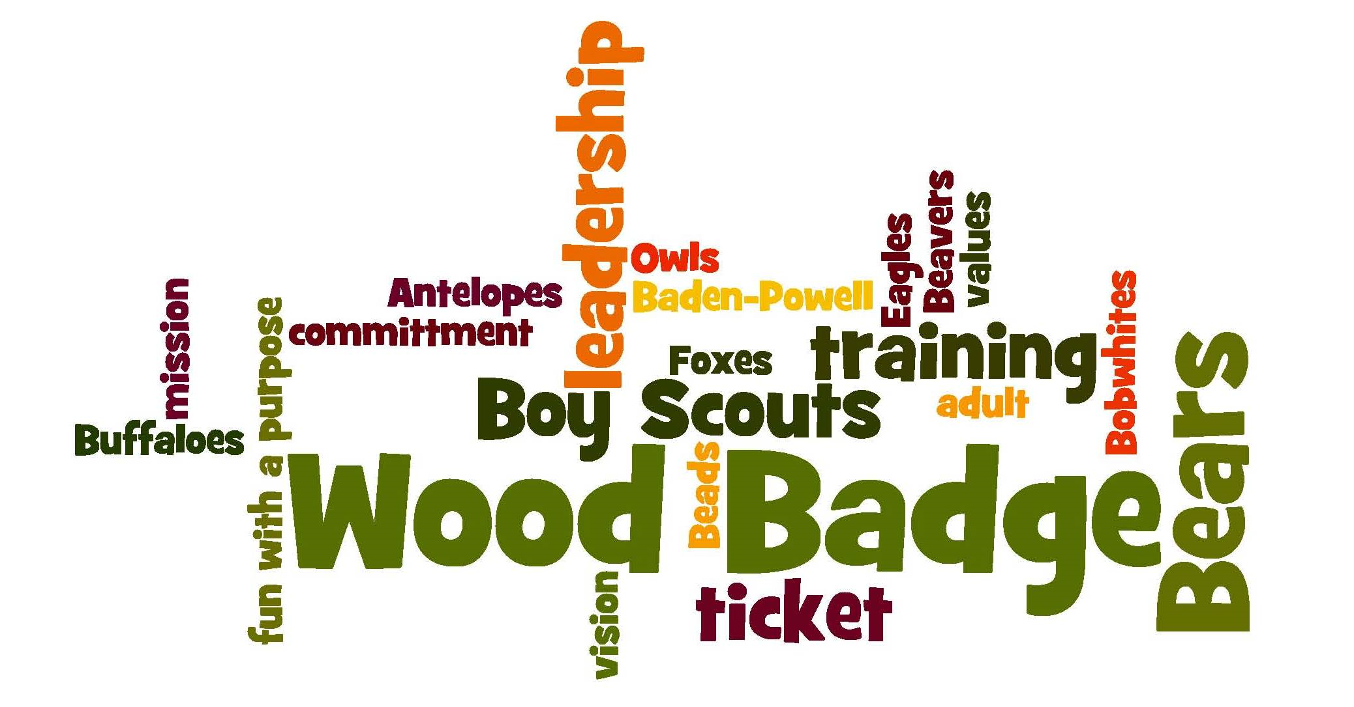
In-Person Training Opportunities
District
Training
Notes:
Scouts BSA Interest Topic

Slide 9
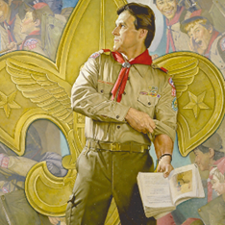

Yawgoog Summer Sessions
Notes:
Scouts BSA Interest Topic

Slide 10



National Training Opportunities
Notes:
Scouts BSA Interest Topic

Slide 11
Adult Leader Development
Questions?
Notes:
Scouts BSA Interest Topic

Slide 12
Tips for Troop Meetings
Suggestions
and
Discussion
12
Notes:
Tips for Troop Meetings (5-8 minutes)
Unit leaders can always use a new idea or approach to keep troop meetings interesting, diverse, and exciting. Roundtable is a great place to share these tips, whether they are pulled from training resources, shared among participants, collected from commissioner observations during unit visits, or found in online Scouting resources.

Slide 13
Song / Skit
Recommended song- Growing Wings - Eagle Scout Song.
(This is a great program addition for an Eagle COH.)
Here is the link to download and embed in slideshow:
https://www.youtube.com/watch?v=-xnEbRKvouA
Recommended skit- Pickpockets.
Here is the link to download and embed in slideshow:
https://www.youtube.com/watch?v=t1_w7p_mTk0
13
Notes:
Song / Skit (3-4 minutes)
A sample song or skit is presented to show leaders how Scouts BSA purposes and ideals can be symbolized in a variety of fun activities. Involve participating units or provide examples from online sources.
Recommended song- Buffalo Song, here is the link to download and embed in slideshow.
https://www.youtube.com/watch?v=Q0HOxoi4fXo
Recommended skit- Making Meatballs, here is the link to download and embed in slideshow.
https://www.youtube.com/watch?v=arEPzPe1Y-U

Slide 14
Future Program Features
  April: Building a Strong 1st Year Program
  May: Troop Summer Activities other than Summer Camp
14
Notes:
Program Feature of the Month (10-15 minutes)
Scouts are looking for an action-packed program full of fun activities. In this section, roundtable commissioners utilize Program Features for Troops and Crews (volumes 1, 2, and 3) to delve into various program features for ideas to help units deliver quality programs.

Slide 15
Questions & Answers
      Q?
      Aha!
15
Notes:
Q & A (5 minutes)
As time permits, roundtable commissioners should answer questions posted to the “parking lot” or any other questions that have come up as a result of the Roundtable discussions. For unique, unit-specific questions, ask for a way to get in touch with the individual after the meeting to provide information needed.

Slide 16
Commissioner Minute
16
Notes:
Commissioner Minute (1 minute)
The content should be thought-provoking and inspirational. It offers encouragement to the participants to use the skills they have learned at the Roundtable to provide a better program for their youth. It can also serve as a model for the Scout Master’s Minute at the end of their troop meetings.

