Slide 1

Narragansett Council
Boy Scouts of America
Welcome to the
May Virtual Roundtable!

Slide 2
Welcome !!!
Notes:
Welcome – One minute
A program-specific roundtable commissioner or assistant district commissioner for roundtables calls the meeting to order and starts welcoming all participants to the meeting. Start on time. It is unfair to those who arrived on time to have to wait. Beginning with an enthusiastic greeting will set the tone for a fun evening of learning and fellowship.

Slide 3









A Scout is Reverent
Notes:
Prayer – Brian Norton
In keeping with the Scout’s duty to God, include a nonsectarian prayer in the general opening session. As some people aren’t comfortable praying in public, ensure success by asking a team member or participant in advance to offer the prayer. Begin with an appropriate introduction such as “prepare yourself for prayer or reflection as is your custom.”
Images shown:
Star of David (Judaism), Christian Cross (Christianity), Star & Crescent (Islam)
Flaming Chalice (Unitarian Universalism), Faravahar (Zoroastrianism)
9-pointed Star (Bahá’i), Wheel of Dharma (Buddhism), Om (Hinduism), Taijitu (Taoism)

Slide 4

Opening Ceremony

Slide 5
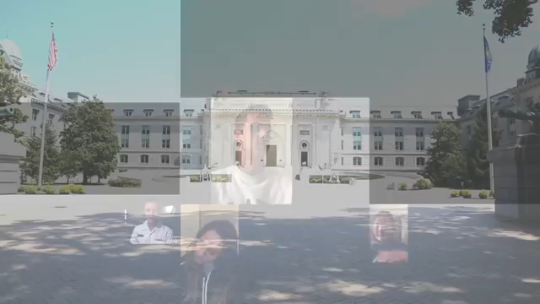
Opening Ceremony

Slide 6
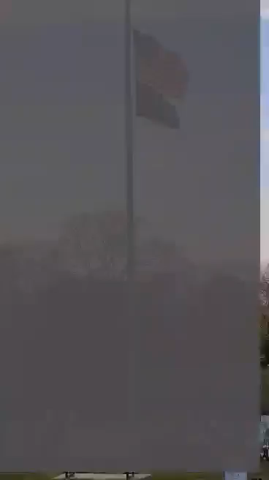

Slide 7
Scout Executive
Tim McCandless
Notes:
Summer camp update
Tom Sisson to give an update on changes that will be made to Summer camps this year

Slide 8
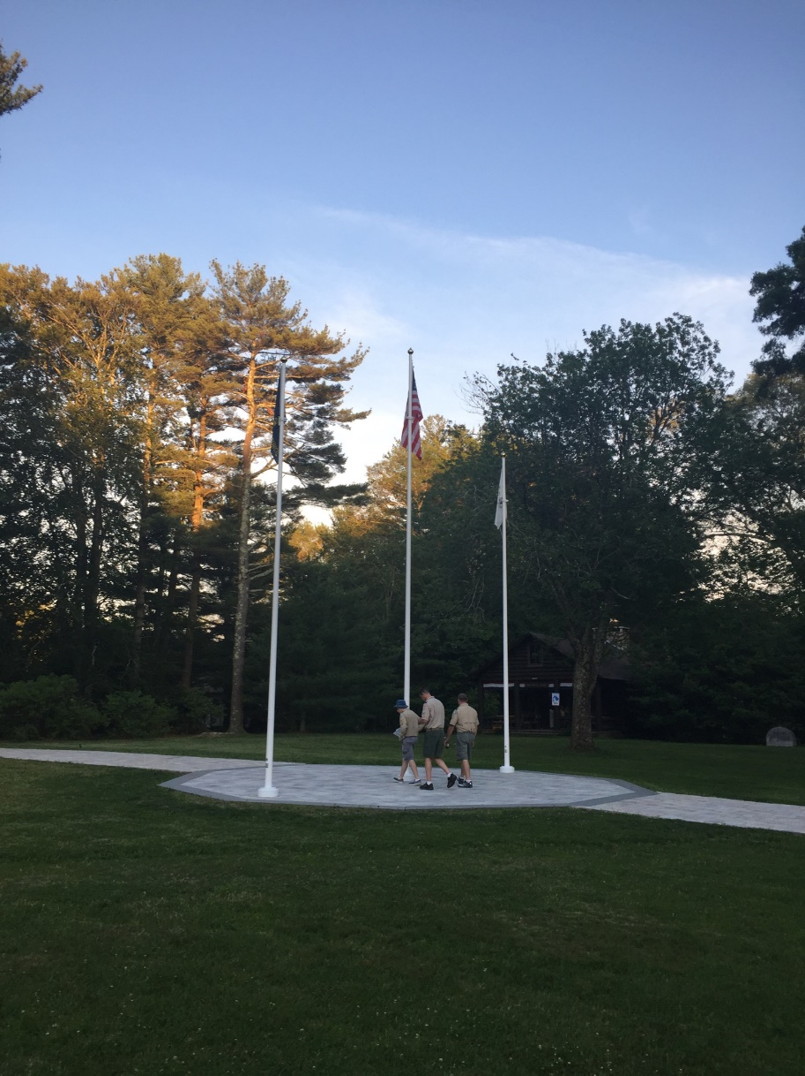
Summer Camp Update
Notes:
Summer camp update
Tom Sisson to give an update on changes that will be made to Summer camps this year

Slide 9
Jamboree Webinar

Slide 10
Scouting for Food

Slide 11
Big Rock
Guide to Safe Scouting
Notes:
Big Rock Training Topic – Five - ten minutes
The Guide to Safe Scouting, some call it the Book of NO!
I think a quote from Baden-Powell’s 1914 book Quick Training for War is a better description as to how to think of the Guide to Safe Scouting.
“…The books lay down definite principles and examples which serve to guide the leaders when applying their common sense to the situation before them. No two situations are ever precisely the same, and it is therefore impossible to lay down exact rules that should guide in every case, but a man who carries precedents and principles in his head has no difficulty in applying their teaching in supreme moments of sudden emergency…”

Slide 12
Notes:
Guide to Safe Scouting
As noted in the preamble of the Guide to Safe Scouting:
All participants in official Scouting activities should become familiar with the Guide to Safe Scouting, applicable program literature or manuals, and be aware of state or local government regulations that supersede Boy Scouts of America practices, policies, and guidelines. The Guide to Safe Scouting is an overview of Scouting policies and procedures gleaned from a variety of sources. For some items, the policy statements are complete. Unit leaders are expected to review the additional reference material cited prior to conducting such activities.
In situations not specifically covered in this guide, activity planners should evaluate the risk or potential risk of harm, and respond with action plans based on common sense, community standards, the Scouts BSA motto, and safety policies and practices commonly prescribed for the activity by experienced providers and practitioners.

Slide 13
https://www.scouting.org/health-and-safety/gss/toc/
Notes:
Guide to Safe Scouting
You can get the Guide to Safe Scouting in print or as a pdf download which is up-to-date as of August 2019 or you can utilize the online version, which is the most up-to-date version.
In either version you’ll find The BSA’s Commitment to Safety which highlights five things you as a volunteer can do to create a safe and healthy Scouting environment.
Know and executing the BSA program as contained in its’ publications
Plan tours, activities, and events with vigilance
Set the example for safe behavior and equipment use during program
Engage and educate participants in discussions about hazards and risks
Report incidents in a timely manner

Slide 14
https://www.scouting.org/health-and-safety/gss/toc/
Notes:
Guide to Safe Scouting
Here is the table of contents for the Guide to Safe Scouting. As you can see it covers a range of topics. The link to the online version is at the bottom of the slide. From there you can also download the most current pdf version.

Slide 15
https://www.scouting.org/health-and-safety/incident-report/
Notes:
Guide to Safe Scouting
In the unfortunate event an incident does happen at a Scouting meeting, activity, or event, make sure you report it to your district executive and the council office.
You can utilize the appropriate form from the appendix in the Guide to Safe Scouting or file an incident report through the BSA website: www.scouting.org/health-and-safety/incident-report/.
An incident report should be filed out for events or allegations of injury, illness, or property damage, including employment and directors and officer’s issues.
The near-miss report form should be used when there was the potential for an injury, illness, or damage to occur but did not.

Slide 16
Guide to Safe Scouting
?
Notes:
Questions?

Slide 17
BSA Topic
Troop Activities Other Than Camp
Notes:
Troop activities other than camp
Summer is the time when scouts and scout leaders want to get outdoors and have fun with their friends. Sometimes attending summer camp lights a fire in them to do and want more out of scouting. There are options during the summer at the troop level that you may want to explore.
Let’s look at what it would take to pull of an extended summer trip.

Slide 18
Extended Trip Planning
Where do the Scouts want to go?
How many scouts plan on attending?
How many adults plan on attending?
What is your per scout cost you are looking to achieve?
How much troop funds will be used to offset the trip cost
Will the SM and driving adults be free, or what will they be expected to pay?
When are deposits due?
Are there any special groups rates that you could get?
How far will your CO let you travel
Notes:
Add questions to the adults attending
How many adults will be driving?
What adults will be staying back in camp while activities take place?
What adults will be participating in the events?

Slide 19
Travel Considerations
  Will you travel by bus or car?
  Will you need to take a gear trailer?
  Where will rest stops be taken (every 4 hours at a min)
  What route will be taken?
  Do all drivers have a printed map of the route?
  Who will you send the itinerary to that is not on the trip?
  Are all vehicle road worthy, inspected, and insured?
  Where is the closest medical facility?
  Where is the closest shopping center?
Notes:
If by Car, how many cars will be needed?
How many passengers will each vehicle carry?
Will you need to rent a vehicle to pull a trailer?
Will you need to rent a trailer?
Is the trip approved by the Troop Committee?

Slide 20
Lodging
  How much will the site cost, and how large is it?
  What does the site look like? Is it an open field or wooded?
  Will you be staying in a cabin or tent camping?
    If tent camping, how ,many tents will you need
  What facilities are on site?
    Picnic tables, fire ring, dining fly, restrooms, etc
  Where can you get clean water?
  Where will you dispose of your trash
  Are open fires allowed?

Slide 21
Food
Food
  What food will you get while on the road and who will pay for it?
  Who will be preparing the meals while away?
  Will any of the meals be pre-cooked and packaged? If so, who will be doing this?
  What will the perishable food be kept in?
  Where will you be able to get ice while away?
  Will it be patrol cooking or troop cooking?
  What will you eat after a long day of activities?

Slide 22
Activities
  What fun activities are in the area (amusement park, water park, ropes course, White water rafting, etc)
  Are the activities appropriate for all ages in the troop?
  What historical sites are around to visit?
  Any local sporting venues to catch a game at?

Slide 23
Baltimore MD Trip
Trip to Maryland will include the following:
Staying at a campsite and tent camping
Visiting Fort McHenry
Taking in a baseball game (Red Sox vs. Orioles) and getting a tour of Camden Yards

Slide 24
Baltimore MD Trip
- Trip will take place over 4 days
- 20 Scouts will be attending
- 4 Adults will be attending
- 4 cars will be used to transport scouts and gear

Slide 25
Baltimore MD Trip

Slide 26
Other Ideas
- High adventure trip for the older Scouts.
- Hiking in a neighboring state.
- Hiking in one of the local mountains.
- Visiting Block Island.
Playing a day of man hunt.
Playing town wide scavenger hunt.
Hiking all of the trails at local camps
Helping out at Cub day camp
Walk the Freedom trail in Boston
Community service
Notes:
There are plenty of other things to do during the summer that can be fun for the scouts and can be done in a day. Let’s take a look at some of them.

Slide 27
Other Ideas if outdoors is not an option
Here are some remote scouting event ideas
Private Mincraft server for scout events / camping / manhunt / shenanigans
D&D style event, where goals are altered to be scouting related
Video / meme competitions ( all following Scout Law & Oath )
Other online private games / events that are accessible only to the unit involved
Notes:
Here are some things that you can do if you are not allowed to go outdoors.

Slide 28
Feedback
Virtual Campout
Virtual Campfire
Merit badges
Training
Notes:
This slide will be used to ask how council is doing.
Who attended the virtual campfire, and how did they like it (mention how many attended)? What could be done differently to attract more people
How many packs are taking advantage of the den and pack meetings that are being offered?
What do scouters think about all of the merit badges that are being offered? Special scout out to all those that have lead or been a 2 deep for a merit badge. Ask them to virtually raise their hand so they can be thanked.
Have people used this time to catch up on the on line training that they are behind on or need to refresh?

Slide 29
Training
Notes:
Bob to add comments here

Slide 30
Online Training @ my.scouting.org
View Position Training Course Listing
Online Course | Total Time to Complete
Youth Protection Training (YPT) | 40 minutes
Charter Organization Representative | 50 minutes
Committee Chair | 2 hours
Cubmaster / Den Leader | 2 hours
Scoutmaster / ASM / Crew Advisor | 3 hours
Benefits of Training
Better Program
Increase Unit Membership
Save time & less work
The 1-2-3 Unit Training Goal
Top 3 leadership positions fully trained (unit leader, CC, COR)
All leaders with a youth contact role fully trained
All registered leaders fully trained

Slide 31
Membership
Notes:
Roger to add comments here

Slide 32
Membership
2020 Spring Recruitment Campaign
June 30th, 2020

Slide 33
Narragansett Council May Roundtable
Virtual Scouting Recruitment
June 30th, 2020

Slide 35
Narragansett Council May Roundtable
BOOM virtual Event
June 10th

Slide 36
Narragansett Council May Roundtable
How are you assisting your Scouts and your adult leaders to keep Scouting within their virtual communities?

Slide 37
?
Notes:
Questions?

Slide 38
Commissioner’s Minute
Notes:
Commissioner’s Minute – Two minutes
This is the chance for the assistant district commissioner for roundtable, or others as appropriate, to give a meaningful thought regarding a point of the Scout Law, or other significant and uplifting message. The Commissioner’s Minute helps bring the general session to a close and transition to the program-specific breakouts. Explain that the next session will begin in a few minutes, and point out the locations.

Slide 39
Thank You...
Notes:
Five minute to move to program areas

