Slide 1

Southeast District
Narragansett Council
Welcome to the
November Roundtable!

Slide 2
Agenda
Welcome
Prayer
Opening Ceremony
Introduction and Announcements
Big Rock
  Working with Community Groups and Schools
Commissioner’s Minute
Move to Program Breakouts

Slide 3

Opening Ceremony
Notes:
Opening Ceremony – Two minutes
Use a simple opening ceremony that leaders will be able to duplicate in their units. You may wish to delegate this opportunity to a particular pack or group, or use participants if appropriate. Use the U.S. flag to emphasize citizenship, respect for the flag, and character development. Other options, such as reciting the Scout Oath, Baden-Powell words of wisdom, celebrating the birthday of Scouting, or demonstrating alternate flag ceremonies, will provide ideas that unit leaders can use to liven up their unit programs.

Slide 4
Introductions and Announcements
Introductions
Unit Attendees
Staff
Guests
Announcements
Video Announcements
District Announcements
  Rechartering!
  Family Friends of Scouting
  Journey to Excellence
Notes:
Introductions – two-three minutes
Although you have already welcomed those in attendance, extend a special welcome to newcomers. You may wish to present them with special recognition or a certificate. Make them feel welcome so they’ll bring additional unit leaders with them to the next roundtable.
Also introduce the Roundtable team and any special guests such as head of a district or council committee, the Scout executive, etc.
Be sure to explain the flow of the evening’s activities. Point out the various program groups and where they will be gathering. Take care of housekeeping items such as the location of restrooms and any policies specific to the building in which you are meeting. This is especially important for your newcomers—do not assume everyone already knows.
Announcements – five-seven minutes
Run the council announcement video, this should cover the majority of announcements to be made.
For announcements not covered by the video, allow a brief promotional statement, about a minute or so. Limit each announcement to a short introductory statement about the event and where more information can be found, such as fliers and websites. Make sure the spokes- people are available for questions and discussion at the preopening information table and assure participants that the handout information will also be available to pick up at the end of the meeting.
Do not let announcements hijack the time and program needs of units! Keep them to a minute or less and emphasize that the fliers contain detailed information.

Slide 5
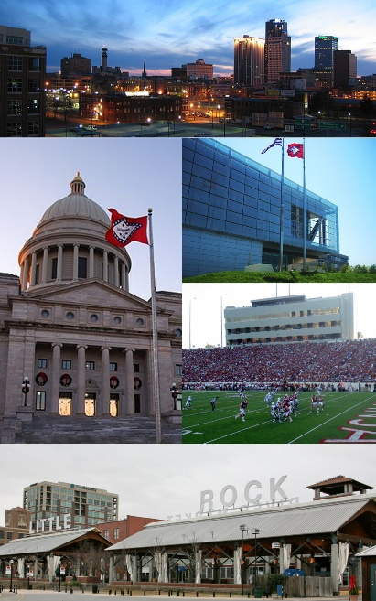
Big Rock
Working with Community Groups and Schools
Notes:
Big Rock Training Topic – Fifteen minutes

Slide 6
Working w/ Community Groups & Schools
A community group is a social, religious, occupational, or other association of people sharing common characteristics or interests and perceived or perceiving itself as distinct in some respect from the larger society within which it exists.
Examples include: VFW, Rotary Club, Knights of Columbus, sports associations, and trade groups
Notes:
Working with Community Groups and Schools
What is a community group?
[Solicit answers from the audience.]
[Advance slide.]
A community group is a social, religious, occupational, or other association of people sharing common characteristics or interests and perceived or perceiving itself as distinct in some respect from the larger society within which it exists.
What are some examples of community groups?
[Solicit answers from the audience.]
[Advance slide.]

Slide 7
Working w/ Community Groups & Schools
Service projects
Recruitment
Unit promotion
Advancement
Notes:
Working with Community Groups and Schools
Usually when we think of community groups or schools we think of chartered organizations. How else can a Scouting unit partner with a community group?
[Solicit answers from the audience.]
[Advance slide.]
Service projects can be done for or in conjunction with many community groups—flagging of cemeteries for veteran groups; working with a local garden club for an Earth Day cleanup; trail cleanup or maintenance for the Audubon Society or other conservation group; or assisting with setup and cleanup at a church festival.
Community groups can help with unit recruitment by allowing units to set up an information booth at their events—youth sports associations; arts groups; PTO/PTA.
Aside from unit promotion at an information booth, community groups can also assist units with promotion by allowing them to march in their parades, be a vendor at one of their festivals (this also provides a money-earning opportunity to a unit), participate in flag or dedication ceremony.
Community groups can be a great resource for advancement for Scouting units. Veterans’ groups are a great resource for those Cub adventure that require them to talk with a veteran or meet a hero. Artists’ groups may be able to provide resources for any of the Cub art based adventures or for art based merit badges such as art, wood carving, and leatherwork. An animal shelter may be able to provide assistance with the Bear Paws for Action adventure or help with the dog care merit badge. Various professional and trade groups and associations can be resources for a multitude of merit badges.
As a side note, if you are looking for an organization to provide someone to be a counselor for a merit badge, make sure they are registered as a merit badge counselor and if not encourage them to become registered as one. It is a no cost position.
In partnering with community groups in these fashions we create visibility for our unit and for Scouting in general.
Now let’s look at how we can work with schools.

Slide 8

Working w/ Community Groups & Schools
BSA Adopt-a-School Program
Voluntary participation
One year commitment
Register your commitment at www.scouting.org/adopt-a-school/
Project ideas include:
  Grounds beautification
  Help during festivals
  Clean up after school events
  Literacy program
Notes:
Working with Community Groups and Schools
With access to school systems in many communities across the country being restricted, the BSA has developed a program to proactively address community/school relationships.
The hope at the heart of the BSA Adopt-a-School program is to build strong, sustaining relationships with your local schools, creating a lasting community partnership. Through committee volunteer efforts — from school cleanup and landscaping to Scouts’ active participation in school events throughout the year — the BSA will become a defined presence in improving our schools.
This is a voluntary program with at least a one year commitment between the unit and the school. The initial contact with the school of your choice should be a person who has a strong connection to that school. Speak with the principal first and then involves others at the school on an as-needed basis.
The unit needs to register their commitment with the BSA at www.scouting.org/adopt-a-school/. Scouts who participate will eligible to receive the patch pictured on the slide.
The schools specific needs should determine how the unit serves the school. However here are few project ideas:
Grounds beautification, help during festivals, book drive coordination, literacy program, and cleaning up after school events.
As a reminder whether for the Adopt-a-School program or when working with a community group, units should be recording their service hours online (accessible through the Legacy Tools in the pull down menu on my.scouting.org.) This in formation is used to tout the community benefits of Scouting when promoting the Scouting program to local school systems, community groups, or when applying for grants. It is also used to show the value of Scouting in the Report to the State locally and the Report to the Nation at the national level.

Slide 9
Working w/ Community Groups & Schools
?
Notes:
Questions?

Slide 10
Commissioner’s Minute
Notes:
Commissioner’s Minute – Two minutes
This is the chance for the assistant district commissioner for roundtable, or others as appropriate, to give a meaningful thought regarding a point of the Scout Law, or other significant and uplifting message. The Commissioner’s Minute helps bring the general session to a close and transition to the program-specific breakouts. Explain that the next session will begin in a few minutes, and point out the locations.

Slide 11
Thank You...
Notes:
Five minute to move to program areas

